Slide 1
Equipping the Church as a Caring Community
Prof. Dr. med. Samuel Pfeifer
EH Tabor Marburg
Klinik Sonnenhalde, Riehen

Slide 3
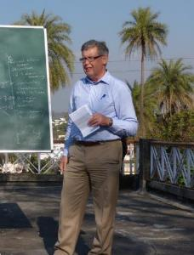
My background
25 years as medical director of a Christian psychiatric Clinic in Switzerland
5 year project in a psychiatric clinic in Bulgaria
Regular visits in psychiatric institutions around the world
Several visits to India / conferences on a «Christian view of mental health» (lectures on the web: www.psy77.com)

Slide 4
Introductory Bible Passages
Isaiah 25:4
You have been a refuge for the poor, a refuge for the needy in their distress, a shelter from the storm and a shade from the heat.
Matthew 9:36-37
Seeing the people, He felt compassion for them, because they were distressed and dispirited (harassed and helpless) like sheep without a shepherd. 37 Then He said to His disciples, "The harvest is plentiful, but the workers are few.…
1. Thessalonians 5:14
And we urge you, brothers and sisters, warn those who are idle and disruptive, encourage the disheartened, help the weak, be patient with everyone.

Slide 5
Mental Health problems – growing concern
WHO: Depression is a hidden burden, affecting around 350 million people around the globe. It is the leading cause of disability worldwide.
Patients tell their stories – in our hospitals, outpatient departments, at the church doors.
Major Mental Health Problems: more than 10 % of the population

Slide 6
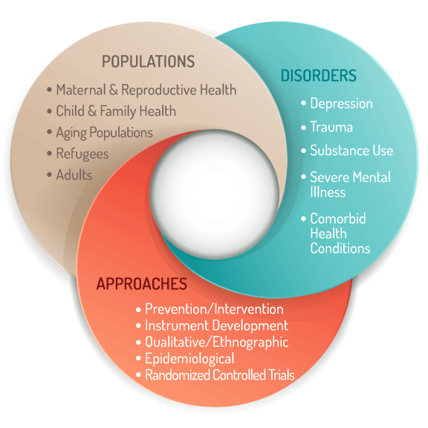
Topics in Global Mental Health
Source: www.globalhealth.duke.edu

Slide 8
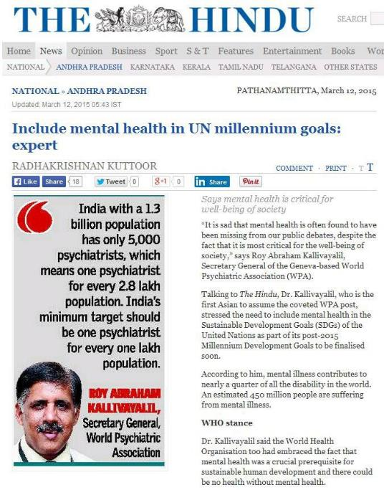
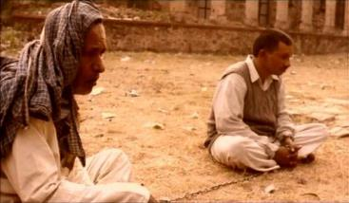

Slide 9
Psychiatry and despair

Slide 10
Mental Health – Four trumpets
WHO: Depression is a hidden burden, affecting around 350 million people around the globe. It is the leading cause of disability worldwide.
Patients tell their stories – in our hospitals, outpatient departments, at the church doors.
Family and friends: almost every person knows at least one person who is affected with symptoms of depression
The Bible records prayers and descriptions of depressive mood.

Slide 11
The multitude of the suffering is at our doors
Who are «the needy in their distress?» (Isaiah 25:4)

Slide 12
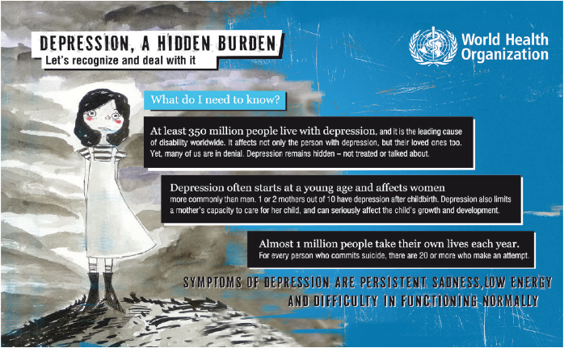
Suffering Souls – the needy of our time

Slide 13
Patients tell their stories
Depression is a common mental disorder, characterized by sadness, loss of interest or pleasure, feelings of guilt or low self-worth, disturbed sleep or appetite, feelings of tiredness, and poor concentration.
Depression can be long-lasting or recurrent, substantially impairing an individual’s ability to function at work or school or cope with daily life. At its most severe, depression can lead to suicide.

Slide 14
There is no Health without Mental Health

Slide 15
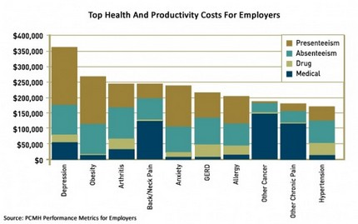
Top health problems

Slide 16
Frequency of mental disorders
SUBST DEP ANX SOM
Notes:
Quelle:
Meyer et al. (2000). Lebenszeitprävalenz psychischer Störungen in der erwachsenen Allgemeinbevölkerung. Nervenarzt 71:535-542

Slide 17
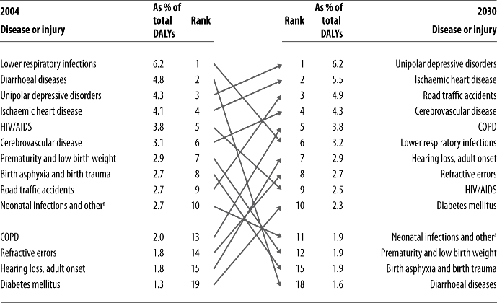
Ten leading causes of burden of disease, world, 2004 and 2030
DALY = Disability Adjusted Life Years (Lost)

Slide 18
General guidelines for mental problem
People with mental health problems are impaired in three areas:
Inability to enjoy life
Inability to entertain social relationships
Inability to work or fulfil social roles

Slide 19
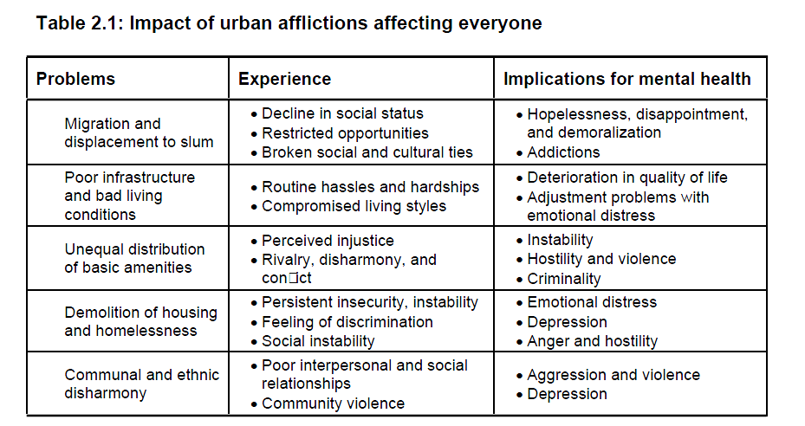
Cultural context of urban mental health
Shubanghi R. Parkar, GENDER AND THE CULTURAL CONTEXT OF URBAN MENTAL HEALTH IN MUMBAI, Dissertation University of Basel 2003
Notes:
Shubanghi R. Parkar, GENDER AND THE CULTURAL CONTEXT OF URBAN MENTAL HEALTH IN MUMBAI, Dissertation University of Basel 2003

Slide 20
Urban afflictions affecting men

Slide 21
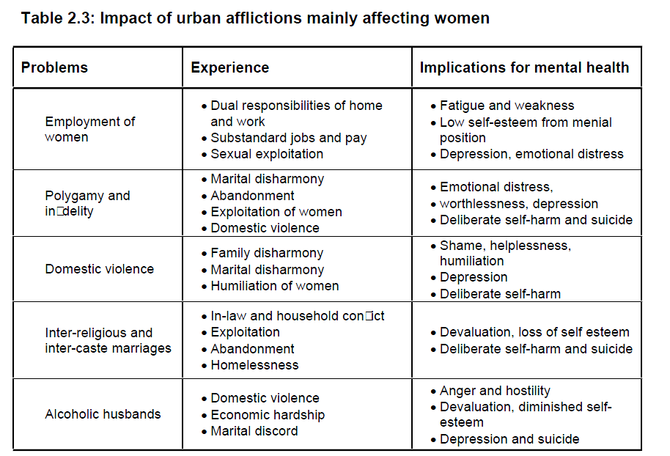

Slide 22
Depression can darken the faith
Research has shown that it is not faith that makes a person unhappy, but that the depressed mood may lead to difficulties in the religious life.
Sad mood, loss of joy and interest.
Brooding and Doubt, unrest and a narrowing focus on depressive ideas.
Self reproach, guilt feelings
Lack of energy, inability to decide
Anxiety leads to withdrawal from church and fellowship
Worry and lack of perspective
Irritability and hypersensitivity
Hopelessness and death wish
Like a dark cloud before the sun, depression can be a dark filter not only in daily life but also in the life of faith.

Slide 23
Depression can be treated!
We have a responsibility to reduce stigma and to help those who are suffering.

Slide 24
Seven Principles of Mental Health in a Christian Context

Slide 25
Chrstian Mental Health Care (CMHC) is COMPASSIONATE
1
The most basic attitude of Jesus was compassion:
Matthew 9,36: He was moved
When he saw the crowds, he had compassion on them, because they were harassed and helpless, like sheep without a shepherd. (NIV)
35-37 - Then Jesus made a circuit of all the towns and villages. He taught in their meeting places, reported kingdom news, and healed their diseased bodies, healed their bruised and hurt lives. When he looked out over the crowds, his heart broke. So confused and aimless they were, like sheep with no shepherd.“ (The Message)

Slide 26
CMHC has to be PROFESSIONAL
2
Although this is probably an emphasis of our time, there are Biblical hints to this.
After having healed a group of lepers, Jesus ordered them to consult the professionals of their time. (Luke 5:15; Luke 17:14)
Ethical guidelines --- professionalism along accepted guidelines (DSM-Diagnosis, APA Treatment Guidelines, Medications)
However, leaving out religious and culturally sensitive aspects, would be unprofessional as well.

Slide 27
Professional Issues
Medical interest, knowledge and continuing education.
Having a model of disease and healing.
Having a model of supportive treatment in chronic illness.
Integrating Psychiatry and Theology on an academic and professional level.
Boundaries: The problem of professional sexual misconduct; acknowledging your own limitations (“He grants peace to your borders” – Psalm 147,14).

Slide 28
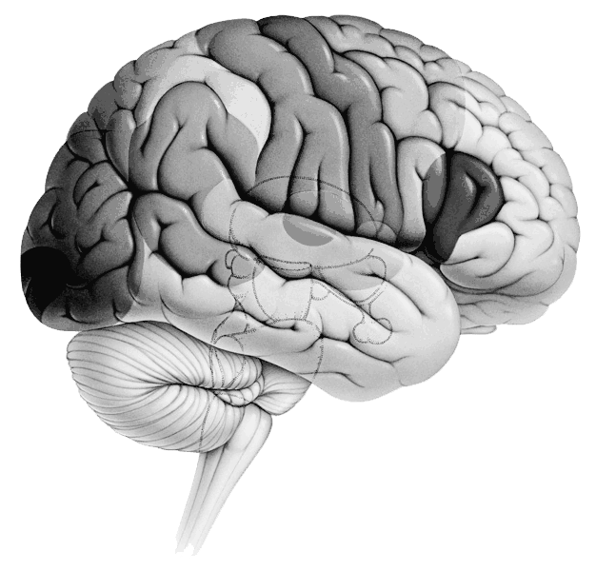
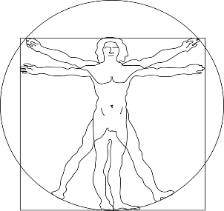
The bio-psycho-social model of treatment
Thinking
Feeling
Behavior
PSYCHO
STRESS
Brain
Family
School
Job
Community
Culture
BIO
SOCIAL
Body functions

Slide 29
The bio-psycho-social model of treatment
1
1
Talking
Support
Activation
Medication
Thinking
Feeling
Behavior
2
PSYCHO
3
4
STRESS
Brain
Family
School
Job
Community
Culture
4
BIO
SOCIAL
3
Body functions
2

Slide 30
Where is spirituality coming in?
SPIRITUALITY
PSYCHO
BIO
SOZIAL
BIO-PSYCHO-SOCIAL MATRIX

Slide 31
Factors contributing to Mental Illness
PSYCHOLOGICAL
Way of Life (Eph 4,22)
Mind (Rom 8,6; 12,2)
Emotions - Thinking
Volition – Behavior
Coping - Defense
Mental Problems
BIOLOGICAL
SOCIAL ASPECTS
Genetics, Personality
Neurobiology
Physical Constitution
Childhood, Family Life
Trauma, Life events
„Stress“
Burden
Hardships
Trials
Temptation
Gal 6,2
2. Cor 6,4
1. Peter 1,6
1. Cor 10,13
Weakness
2. Cor 12,9

Slide 32
Therapeutic avenues
Proberbs 16,24; 18,21
1. Thessalonians 5,15
Hebrews 10,24-25
T A L K I N G
Attention, Empathy, Understanding, Counselling Comfort, Encouragement
Teaching
Patient
M E D I C A T I O N
S U P P O R T
Antidepressants, Neuroleptics, Mood Stabil. Tranquilizer etc.
Visiting - Helping
Aktivation – Enabling better autonomy
Isaiah38,21
J. Sirach 38,1-8
1. Timothy 5,23
Galatians 6,2
Matthew 25,35-40
Proverbs 3,27

Slide 33
Four Biblical Strategies
1. Thessalonians 5:14
1. Exhort
ATACTOS idle, unruly
2. comfort, encourage
Anxious, timid
3. support, help
The weak
4. Be patient
everyone

Slide 34
Admonish, Exhort, Correct - ATACTOS
3
Life Style influences health
Mental Health is influenced by wrong behavior patterns, e.g. alcohol, violence, wrong thinking
We need programs to help people get away from substance abuse.
Marriage Encounter – Teaching foundations of a good relationship and family life
Teaching Biblical Values

Slide 35
Comfort, encourage, reassure
4
Good words are a balm for the soul
Encouraging a person can help to bring out the best in her and motivate her to go on despite the burdens of life
Whom? – The anxious, the depressed, the suffering, those who are mourning etc.
God is also a God of Comfort (2. Cor. 1)

Slide 36
Support the Weak
5
A biblical concept of WEAKNESS in relation to the Mental Health concept of VULNERABILITY, of psycho-social burden, of disability through chronic mental health disorders (DALY)
Who are the weak in mental health?
Those who cannot change despite their efforts and good desires

Slide 37
Support the Weak
5
Biblical emphasis of WEAKNESS
2. Corinthians 12:11
2. Corinthians 4:6-10
Isaiah 42:1-4: bruised reed, smoldering wick

Slide 38
PATIENCE
6
In our world of fast internet connections and instant solutions – mental problems take their time
We should be patient WITH ALL PEOPLE
Giving them time to change, to heal, to mature into the image of God
Colossians 1:11: «being strengthened with all power according to his glorious might so that you may have great endurance and patience.”

Slide 39
HOPE and MEANING in trouble
7
God is a God of Hope
Isaiah 43:1-4
Hope in mental health services
Spiritual aspects of hope and meaning (Victor Frankl)
False ways to find hope (superstition, over-reliance on medicine / other people)
The use of hopelessness – acceptance of weakness

Slide 40
The church has resources to care
Together with Christian professionals, the church can offer couselling and care

Slide 41
EHA task force «Mental Health»

Slide 42
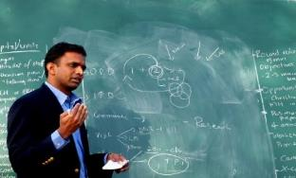
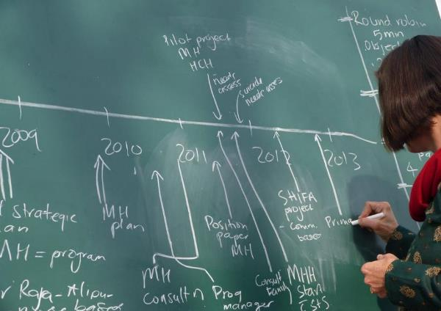
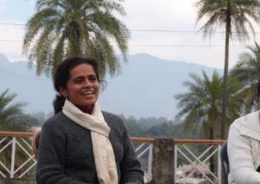
Project reports

Slide 43
Community Mental Health
Very few professional psychiatrists
Alternative avenue: Training social workers and nursing staff as well as counselors to recognize mental illness
Offering basic possibilities of treatment and counseling
DR. KAAREN MATHIAS, MUSSOORI

Slide 44
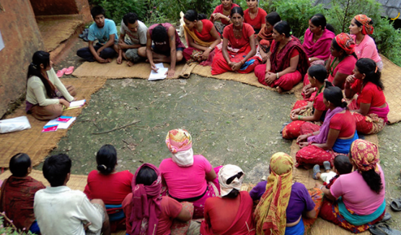
Excellent Training Material
Available from:
www.basicneeds.org

Slide 45
Depression can be treated
Talking
Support
Activation
Medication
1
Thinking
1
2
STRESS
4
3
2
4
Where is the church coming in?
Counselling? Care?
Body
3

Slide 46
An innovative project in India
EHA-Project in Bijnor, UP, India:
Identifying Patients in the context of Primary Health Outreach
Taking them together and riding on a train to the next Mental hospital
Receiving prescription for medications
Follow-up in the community

Slide 47
Faith as a source of strength in depression
Despite despair, doubt and lack of energy
Bible verses and Christian songs
Encouragement by fellow Christians
Blessed are those whose strength is in you, whose hearts are set on pilgrimage. As they pass through the desert valley, they make it a place of springs; the autumn rains also cover it with pools. They go from strength to strength . . . (Psalm 84)

Slide 48
Saddleback Church Program of Mental Health
C - Care H - Help U - Unleash Volonteers R - Reach out C - Cooperation H - Hope

Slide 49
Conclusions
1. We should be open for a deep personal awareness of human suffering beyond all categorical and theoretical considerations, moving us to compassion and motivating us to find new ways for creative caring.
2. We should be aware of new developments in our field, able to communicate with the world, to examine the philosophical underpinnings, critically evaluating what we can apply in our everyday practice.

Slide 50
Conclusions ctd.
3. We should be guided by the Word of God as an eternal source of wisdom and truth, practicing an exegesis that applies to the burdens, the questions and the spiritual hunger of our patients.
4. We should be guided by the principle of hope, hope which is not only rooted in the prospect of restored health, but hope in the midst of existential weakness, hope which is not only based on well-being in this world but hope that goes beyond all that our limited activity can achieve.

Slide 51
God’s changing power: Meena
Heavy burns after suicide attempt
The love of Christian doctors
Changed perspectives
A new ministry

Slide 52
www.psy77.com
More Presentations on Global Mental Health in a Christian Context

