Slide 1
Christian Alternatives to Demonic Interpretations of Mental Distress Theological interpretations and clinical implications – critical enquiry Prof. Dr. Samuel Pfeifer

Slide 4
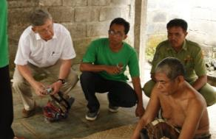
My background
My first experience of «deliverance ministry» in a Christian camp.
Prejudice: Mental illness demon-induced
25 years as medical director of a Christian psychiatric Clinic in Switzerland
Listening to hundreds of stories about demonic interpretations and stigma.
Publications on the topic: Google: pfeifer demons switzerland pdf

Slide 5
Two examples
50y old woman with dissociative identity disorder – difficult behavior.
Church: She probably has a Demon
But what about the rapist?
WHO HAS A DEMON?
African Woman consulting with pastor for depression: «You have a demon of depression!»
If she has an abusive husband – Does prayer solve the problem od depression?

Slide 6
But is belief in demons not a central truth of the Christian faith?

Slide 7
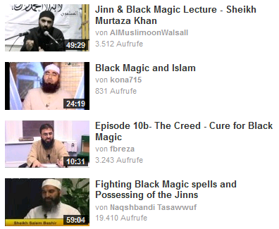
Demonic interpretation is not Christian
«Do you believe in Demons?»
Hinduism
Buddhism
Islam (Jinn)

Slide 8
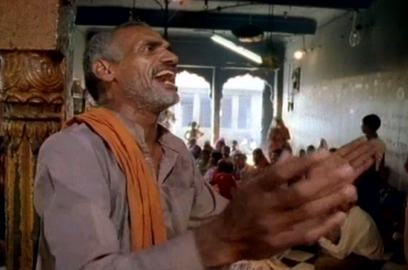
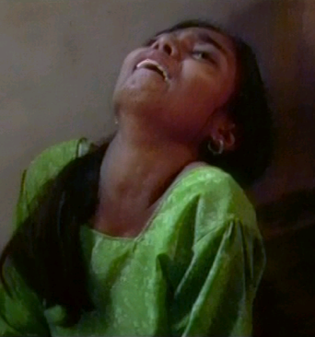
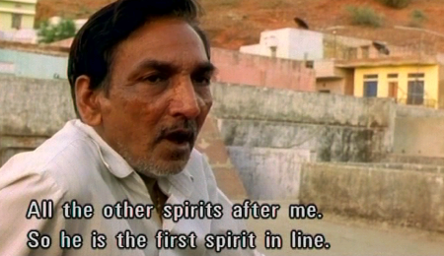
Film «Kusum» /India

Slide 9
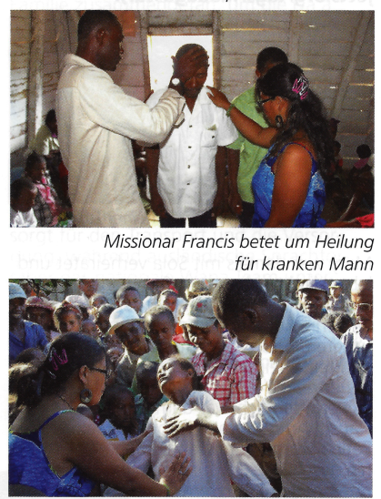
Mental Symptoms interpreted as «demonic»
«Woman refuses her demon being driven out»
Report in a Chrstian NGO magazine 2015

Slide 10
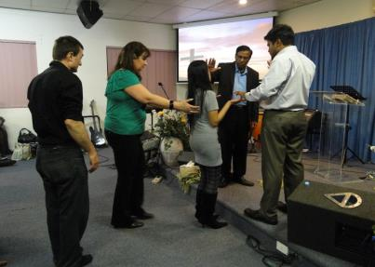
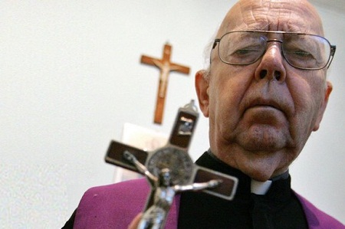
Deliverance Ministry - Exorcism
Deliverance Ministry
Father Gabriele Amorth
www.deliveranceministry.com.au

Slide 11
Common features across cultures
Unusual behavior with and without spiritual aspects (not necessarily classifiable as mental disorder)
The usual medical treatments do not bring improvement
People around or the patient herself suspect spiritual / demonic cause
Some possible reasons: breaking of a cultural taboo (religious or moral) or negative actions against the person (witchcraft, spell, evil eye)
Consultation of a healing person (Imam, Hodja, priest, deliverance pastor)
Diagnostic procedure elicits unusual behavior, which strengthens the suspicion of a demon .
Performance of a ritual in the specific cultural tradition (with and without paraphernalia e.g. holy water, herbs, blood, amulets etc.)
After the successful improvement of suffering, the afflicted person thanks his or her God, idols (and the healer)

Slide 12
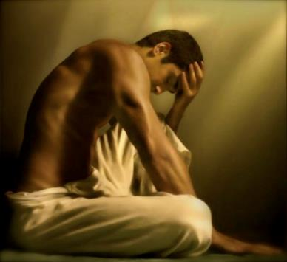
Questions in Suffering
Why me?
Why now?
What is going wrong?
How long will it last?
How serious is it?
Who can help and treat my illness?

Slide 13
The WHY-Question and the Bible
John 9:2-5
His disciples asked him, “Rabbi, who sinned, this man or his parents, that he was born blind?”
“Neither this man nor his parents sinned,” said Jesus, “but this happened so that the works of God might be displayed in him.
As long as it is day, we must do the works of him who sent me. Night is coming, when no one can work. While I am in the world, I am the light of the world.”

Slide 14
Overview
Definitions
Causal attributions and stigma
Theological considerations: are mental problems demonic?
Alternative Explanations compatible with Scripture and compassionate care
Conclusions

Slide 15
Spiritualization
Incidents and experiences are interpreted in a religious context
The interpretation relates to causality and change (therapy) of problems.
Subjective experience is perceived in a comprehensive spiritual context

Slide 16
Common assumptions in India / Africa
Sources:
S Grover et al. (2014). Relationship between First Treatment Contact and Supernatural Beliefs in Caregivers of Patients with Schizophrenia. East Asian Arch Psychiatry 24:58-67.
Kulhara P et al. (2000). Magico-religious beliefs in schizophrenia: a study from North India. Psychopathology 2000;33:62-68.
Odinka P.C. et al.(2015). The sociocultural conceptualisations of schizophrenia and patterns of help seeking in south-east Nigeria. Mental Health, Religion & Culture 18:85-96.
Sorcery / witchcraft 17 (26.2 %)
Ghosts 14 (21.5 %)
Spirit intrusion 19 (29.2 %)
Divine wrath 24 (36.9 %)
Planetary influences 29 (44.6 %)
Evil spirits 20 (30.8 %)
Bad deeds in previous life 28 (43.1 %)
Notes:
Paul Chigozie Odinka, Rosemary Chizobam Muomah, Appolos Chidi Ndukuba, Martins Oche, Michael Ubigha Osika, Muideen Owolabi Bakare, Ahamefule O. Agomoh & Richard Uwakwe (2015). The sociocultural conceptualisations of schizophrenia and patterns of help seeking in south-east Nigeria. Mental Health, Religion & Culture 18:85-96.

Slide 17
Christian concept «Occult Bondage»
«Occult bondage» is understood as demonic influence on a person, which exceeds the „natural“ influence of Satan but does not reach the degree of possession in the more narrow sense.
Frequently, Christians draw a direct line between a history of „occult involvement“ and mental problems.
If you look thoroughly enough into a person’s individual or family history, you will find occult involvement in the widest sense.
The deduction: A person has a mental problem because there is a history of „any occultic, cultic, or non-Christian religious practices“ (e.g. Neil Anderson or Charles Kraft and other authors).
Biblically, this causal attribution is not justified. (cf. John 9:2)

Slide 18
Belief in demonic causality (in percent)
Pfeifer, 1994

Slide 19
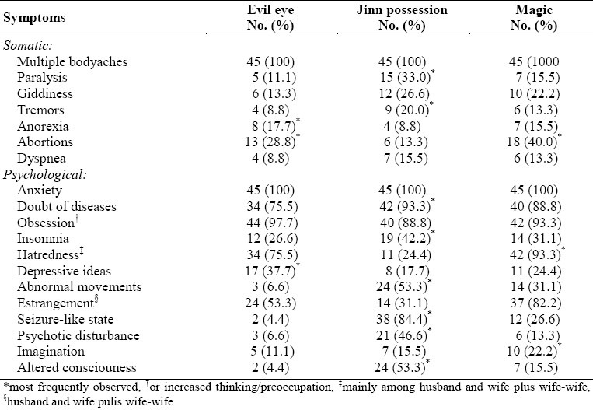
Interpretation Jinn – Saudi-Arabia
Al-Habeeb 2003. J Family Community Med. 2003 Sep-Dec; 10(3): 31–38.
Notes:
J Family Community Med. 2003 Sep-Dec; 10(3): 31–38.

Slide 20
Mosaic of Causal Attributions
Bio-psycho-social Model
Conflicts from Individual Experience
Pfister, S. & Thiel, S. (1999). Religiosität und subjektive Krankheitstheorie. Eine empirische Untersuchung bei 53 psychiatrischen PatienInnen. Dissertation Medizinische Fakultät der Universität Bern.
Cultural Traditions
Alternative Body Theories and Diets
Religious Convictions
Spiritual and Magical Beliefs

Slide 21
The danger of causal atributions
The connection of two true statements by the term «BECAUSE» may be misleading
true
true
Cars pollute the environment
Cars cause accidents
FALSE:
Cars cause accidents
BECAUSE
they pollute the environment

Slide 22
Theology: two approaches
The theological point of view: Biblical texts and theological insights and models are being applied to practical counseling situations. Because the Bible talks of demons, there have to be conditions which fit this model of causation.
The pragmatic-inductive approach tries to find theological causes for human behavior, especially when it implies dysfunction, suffering and deviance. Thus some counselors do not only speak of the „sin of pride“ but simply a „demon of pride“.
Notes:
1. The theological point of view: Biblical texts and theological insights and models are being applied to practical counseling situations. Because the Bible talks of demons, there have to be conditions which fit this model of causation.
2. The pragmatic-inductive approach looks at counseling problems and tries to find theological causes for human behavior, especially when it implies dysfunction, suffering and deviance. Thus some counselors do not only speak of the „sin of pride“ but simply a „demon of pride“. The church fathers in the 4th century had a very practical demonology

Slide 23
Demonology of the early Church fathers
Demon of debauchery
Demon of fornication
Demon of greed
Demon of sadness
Demon of anger
Demon of Acedia (laziness)
„The battle with the demons is primarily fought in a battle with their own thoughts. These are emotionally loaded and not merely intellectual in nature. Closer examination of the church fathers view of demons reveals their desire to explain phenomena.“

Slide 24
Three levels of Satan’s activity
Level 1:
Consequences of the Fall: weakness, decay, sinful nature, "flesh", affects all
Rom 7:18-25, Rom 8:5, 20-21
Level 2:
adversity, temptation
Job 1:6 -12, Luke 22:31, Ephesians 6:11
Level 3:
forbidden occult activities Acts 13:8ff, Acts 16:16-18
Conclusion: Satan is not only active when a person has willingly yielded to occult activities. Even people who have not dabbled with the occult at all, can suffer from mental and bodily weakness (which could - theologically - be interpreted as a satanic adversity).

Slide 25
Symptom List (Example)
abnormal, irrational fear
abnormal, irrational anxiety
abnormal, irrational loneliness
lack of self control
conflicts with authority figures
aimlessness; the feeling that life is void of any meaning or purpose
depression that is not physiologically induced.
outburst of hatred
violent behavior
loss of the fear of God
selfish ambition (appetite for power)
irrationality, inability to detect or correct contradictions or other fallacious reasoning
Notes:
Source: http://www.eternaldestiny.com/DDemons.html

Slide 26
Biblical pairs of opposite terms ?
God |  | Satan
Angels |  | Demons
Light |  | Darkness
Good |  | Evil
Righteousness |  | Sin, Guilt
Spirit |  | Flesh
Health |  | Disease
Freedom |  | Bondage
Peace |  | Anxiety
Joy |  | Depression
Confidence |  | Timidity
Victory |  | Failure
?
Notes:
Biblical pairs of opposite terms ?
God ‑ Satan
Angels ‑ Demons
Light ‑ Darkness
Good ‑ Evil
Righteousness ‑ Sin, Guilt
Spirit ‑ Flesh
Health ‑ Disease
Freedom ‑ Bondage
Peace ‑ Anxiety
Joy ‑ Depression
Confidence ‑ Timidity
Strength ‑ Weakness
Victory ‑ Failure

Slide 27
Critical questions
Why does Jesus never construct a connection between demon-induced suffering and occult activity?
Why is Jesus seeing demons even behind bodily diseases which we would not associate with demonology?
To what extent was Jesus adopting cultural views of pathology when casting out demons? (excellent discussion: Virkler, p. 294) – example: Mt 15:21-28: Here the woman is making the attribution to a demon, not Jesus.
How do we integrate the views of other religions on demons and exorcism into our world view (often they are very close to the gospel accounts).

Slide 28
Critical questions II
Why are the New testament letters silent about exorcism while at the same time mentioning various other counseling approaches? (discussion: Anderson, Bondage Breaker, p. 216)
What are the consequences of blaming demons for behavioral and emotional problems?

Slide 29
Hearing voices – five explanations
Inner dialogue: for some people at certain times this dialogue can become so intense that they have the impression of two fractions of themselves talking to each other.
Dissociative Identity Disorder (formerly: Multiple Personality Disorder, MPD): very rare condition in persons with extreme traumatization in childhood.
Psychotic phenomenon in schizophrenic disorders: subjectively very frightening and threatening (sometimes also comforting); content: varied— Information processing disorder which is typical of a complex dysfunction of certain brain areas and occurs in the context of typical symptoms of schizophrenia.
Drug-induced hallucinations
Organic hallucinations: repetitive sentences / melodies
Conclusion: The variety of natural / biological explanations of hearing voices makes this criterion irrelevant for the „diagnosis“ of demonic phenomena.

Slide 30
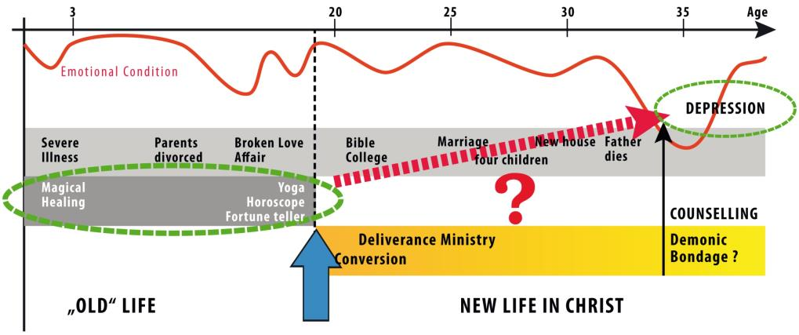
„Demonic Bondage“ and biographical context

Slide 31
Shortcomings of the demonic model
Weak and limited Biblical foundation (Saul, Nebukadnezar, the Gadarene) – the demonic is no consistent Biblical model (it is not mentioned in all the NT letters)
Family „bondage“ is assumed, as there is no actual relationship with the demonic
Failure of persistent healing despite deliverance prayers (patients suffer relapse in mental disorders)
Emotional hurt / trauma: mental distress is related to Satan (despite the faith life of the person)
Frustration / discouragement of the counselor
Obstacle to a biblical perspective in compassionate long term care of the emotionally suffering

Slide 32
Four propositions
The concept of „demonic bondage“ has to be replaced by Biblical terms. It cannot be sufficiently supported by careful biblical exegesis. None of the letters in the new testament suggest casting out of demons as a regular counseling practice.
Emotional problems are not sufficient to assume a demonic influence on a person.
Natural causes which afflict us all as fallen, imperfect, sinful and weak creatures, are sufficient to explain emotional disorders.
We have to be careful not to make extreme examples of Christ’s ministry (such as the healing of the Gadarene) the basis of a general „Theology of occult bondage“. Careful distinction of folk superstition in a Christian gown is necessary.

Slide 33
Alternatives to Demonic Interpretations
Mental Distress is often described in the Bible without demonic interpretations
Some terms: weary, burdened, worried, timid, fainthearted
WEAKNESS (2 Corinthians 12:8-10, Hebrews 4:15 ff)
MIND: negative thoughts
EMOTIONS: distress, suffering
BEHAVIOR: conduct (may be disturbed in severe mental illness)

Slide 34
Practical Steps
Listen carefully
Disentangle the various factors of the syndrome (natural explanations?)
Help the patient gain control
better ways to deal with everyday stress
controlling catastrophic emotional reactions (premature demonic explanations)
redefine acceptable expectations.
separating out old interfering issues.
Notes:
Practical Steps
A. Listen carefully
B. Disentangle the various factors of the syndrome
C. Help the patient gaining control over the symptoms
better ways to deal with everyday stress
controlling catastrophic emotional reactions (premature demonic explanations)
redefine acceptable expectations.
separating out old interfering issues.
D. Support Regaining of a Sense of Self
use resources (skills, friends, church etc.)
strengthen family.
E. Psychopharmacology
Preparing a person to consider medication
self-responsibility for decision
medication can help you to better cope and control distressing symptoms
changing the alarm threshold
calming the biological self
Antidepressants
Anti-anxiety drugs
sleep drugs

Slide 35
Practical Steps II
D. Support Regaining of a Sense of Self
use resources (skills, friends, church etc.)
strengthen family.
E. Medication
medication can help you to better cope and control distressing symptoms
changing the alarm threshold
calming the biological self
Antidepressants / Anti-anxiety med./ sleep med.
Notes:
Practical Steps
A. Listen carefully
B. Disentangle the various factors of the syndrome
C. Help the patient gaining control over the symptoms
better ways to deal with everyday stress
controlling catastrophic emotional reactions (premature demonic explanations)
redefine acceptable expectations.
separating out old interfering issues.
D. Support Regaining of a Sense of Self
use resources (skills, friends, church etc.)
strengthen family.
E. Psychopharmacology
Preparing a person to consider medication
self-responsibility for decision
medication can help you to better cope and control distressing symptoms
changing the alarm threshold
calming the biological self
Antidepressants
Anti-anxiety drugs
sleep drugs

Slide 36
Strategies of Helping
Understanding the nature of the disorder (does it have a psychological / medical explanation?)
Choosing an appropriate action (1. Thess. 5:14)
Medication to soothe the pathological symptoms
Spiritual support (prayer, encouragement)
Practical support (social work)

Slide 37
Demonizing = spiritual abuse
„Ich habe in zahlreichen Fällen erlebt, welch ungünstige Wirkungen auf einen seelisch kranken Menschen ausgehen können, wenn er fälschlicherweise als dämonisch gebunden bezeichnet wird. Es ist ein grosses Unrecht, wenn ein unter diesem Zustand leidender Gemüts- und Geisteskranker den Vorwurf hören muss, er sei in die Gewalt des Teufels geraten. Wer ohne Kenntnis des krankhaften Seelenlebens und dämonischer Zustände sich ein solches Urteil anmasst, der handelt höchst voreilig, ja geradezu grausam.“
Alfred Lechler, Krankheit oder Dämonie?

Slide 38
Attitudes in approaching the unfamiliar
1. Compassion
2. Humility
3. Comprehensive diagnostics and care
Let us follow the example of Jesus:
When he saw the crowds, he had compassion on them, because they were harassed and helpless, like sheep without a shepherd. (NIV)

Slide 39
www.psy77.com
More Presentations on Global Mental Health in a Christian Context

