Slide 1
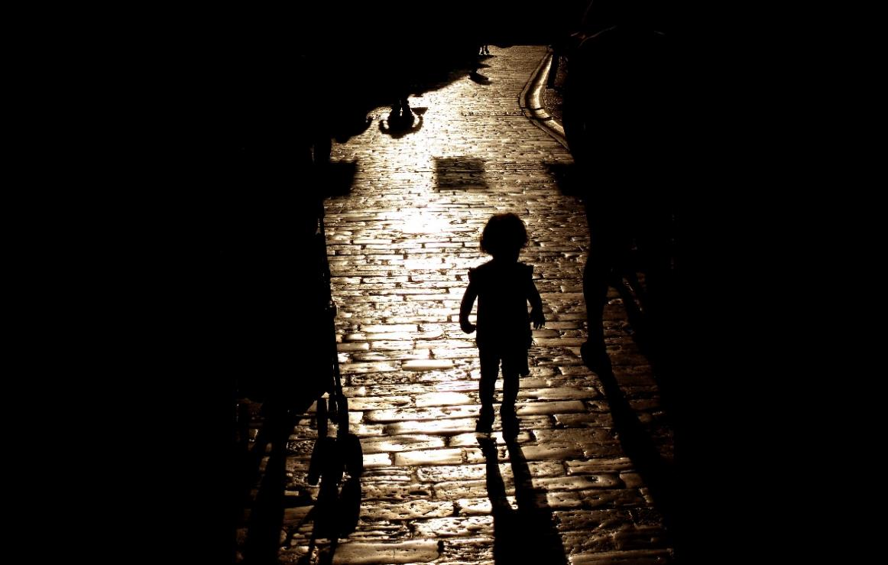
Prof. Dr. Samuel Pfeifer, Switzerland
www.seminare-ps.net
Notes:
Jennifer Lawrence als Katniss Everdeen / Hunger Games

Slide 2
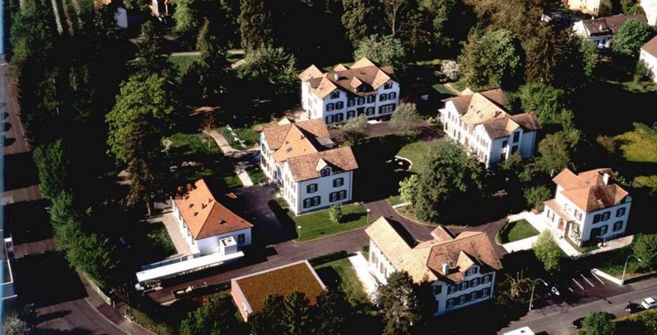
My background
Medical Director of a Mental Health Clinic in Switzerland for 25 years
Keen interest in the integration of spirituality and mental health
Global Mental Health
Professor for psychotherapy and mental health at Evangelische Hochschule Marburg / Germany
Insight from psychotherapy

Slide 3
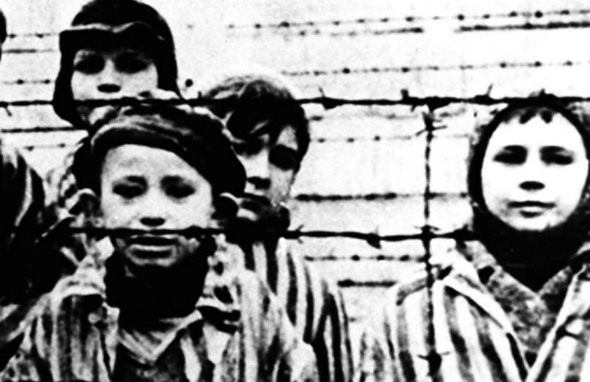
Case study “George”
60-year old teacher – “George”
His Jewish father was persecuted in Austria and on a deportation list; he was able to flee to Switzerland, where he found refuge under dramatic circumstances. Constant fear of the authorities.
He married and had 2 sons, whom he instructed not to tell anybody of their Jewish descent. So George grew up with this dark secret and with the emotional pain of his father.
Today he says: “There is definitely transgenerational trauma – I am daily reminded by my anxieties and my mistrust in all surveillance techniques of the Internet.”

Slide 4
Transgenerational Trauma is a fact
Transgenerational transfer of trauma associated symptoms has been observed in many settings; especially where individuals tell their stories (often in psychotherapy).
Manifestation in anxiety-loaded dreams, phantasies, self-image, emotional reactions, unconscious acting in descendants of traumatized persons (especially children and grandchildren of holocaust survivors)
Notes:
Besonders bei Kindern und Enkeln von Überlebenden des Holocaust wurde dieser Zusammenhang seit Mitte der sechziger Jahre offensichtlich, als die nun jungen Erwachsenen der zweiten und dritten Generation vermehrt therapeutische Hilfe suchten (Grubrich-Simitis 1979; Rosenthal 1997).

Slide 5
How can we explain the findings?
Trauma transmission has been observed by many therapists. Already Sigmund Freud talked of “emotional heritage”.
Unconscious transmission by “transference” and “counter-transference” – family reactions which are difficult to understand by the child – constant impression of hidden danger and threat.
Culture of remembrance, constant confrontation with the fact of holocaust in memorials, stories, movies.
Experiencing humiliation, threats, acts of terrorism
New development: genetic research >>> EPIGENETICS

Slide 6
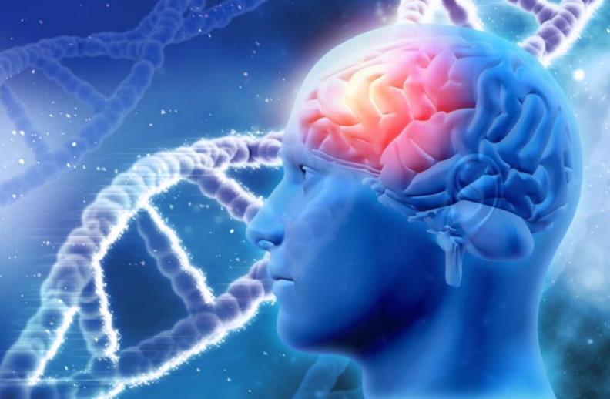
What is Epigenetics?
Epigenetics postulates that traumatic experiences in the mind can have an impact on the DNA in maternal egg and paternal semen.
Thus, in offspring, mental mechanisms are triggered resembling posttraumatic stress reactions, although the child has not actually experienced the original trauma of the parents.
Notes:
Epigenetics is the study of inherited biological triggers that affect genes and how cells in the body react to genetic information, but that do not alter underlying DNA sequences.

Slide 7
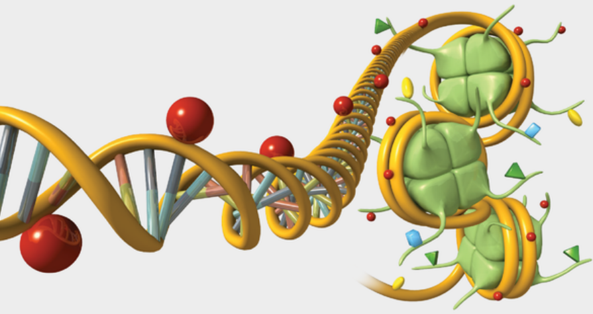
Mechanics of Epigenetics
Epigenetics is the study of inherited biological triggers that affect genes and how cells in the body react to genetic information, but that do not alter underlying DNA sequences.
There seem to be chemical reactions which modulate the expression of DNA, without changing the sequence of DNA (Methyl and Histone groups).
Methyl (red) and Histone groups (green)
Source: Scientific American
Notes:
https://blogs.scientificamerican.com/sa-visual/gene-regulation-illustrated/
Epigenetics is the study of inherited biological triggers that affect genes and how cells in the body react to genetic information, but that do not alter underlying DNA sequences.

Slide 8
Research background
2018
Notes:
Yehuda R., Lehrner A.
Intergenerational transmission of trauma effects: putative role of epigenetic mechanisms. World Psychiatry 2018 Oct;17(3):243-257.

Slide 9
Findings from the American Civil war

Slide 10
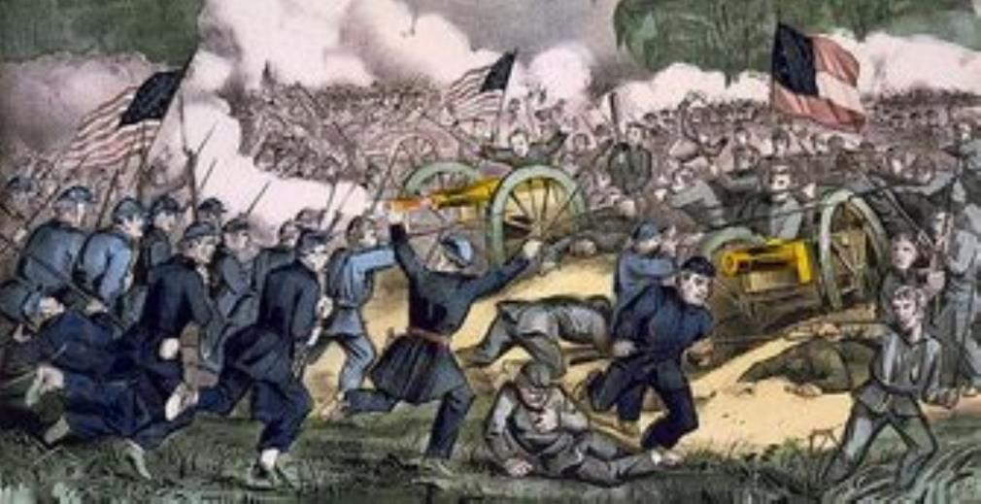
Findings from the American Civil War 1861 - 1865
After accounting for differences in socioeconomic conditions, Costa found that the sons of ex-POWs in the worst camp environments were 1.11 times more likely to die at any given age after 45 years old than the sons of non-POWs and 1.09 times more likely to die at any given age than the sons of POWs when camp conditions were better.
“I originally thought the key factor in the children’s longevity would be socioeconomic status,” Costa said. “But then I started to notice the effect was only happening in the sons — which is in keeping with an epigenetic cause — and only to the sons born after the war.”

Slide 11
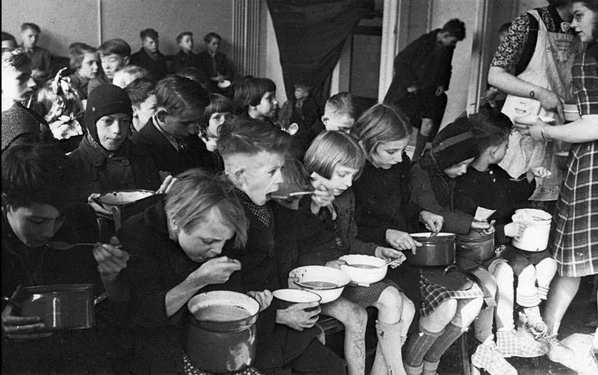
The hunger winter in Holland 1944
In 1944, the Nazis punished the Netherlands by blocking food supplies, plunging much of the country into famine. 20,000 people had died of starvation.
unplanned experiment in human health. Pregnant women, were uniquely vulnerable, and the children they gave birth to have been influenced by famine throughout their lives.
When they became adults, they ended up a few pounds heavier than average. In middle age, they had higher levels of triglycerides and LDL cholesterol. They also experienced higher rates of such conditions as obesity, diabetes and schizophrenia.

Slide 12
Laboratory findings in mice
Studies at the University of Maryland School of Medicine: raising mice in stressful environment: tilting cages, leaving light on – constant stress = traumatic childhood.
Effect: changes the subsequent behavior of those mice’s genes in a way that alters how they manage surges of stress hormones.
Passed on to next generation: how their offspring handle stress: namely, the young mice are numbed, or less reactive, to the hormones compared to control animals, said Dr. Bale, director of the university’s Center for Epigenetic Research.
NYTimes – 2018

Slide 13
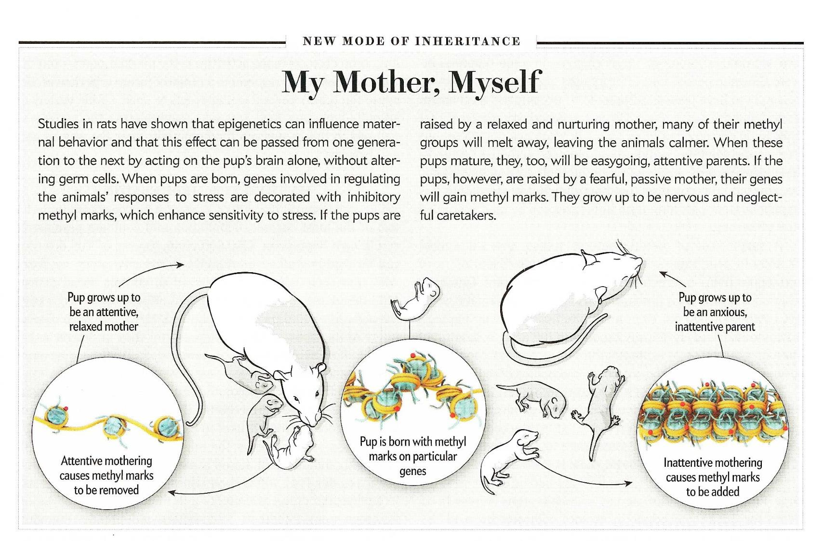
December 2011
Notes:
Scientific American December 2011

Slide 14
Open Questions
No one can explain exactly how, say, changes in brain cells caused by abuse could be communicated to fully formed sperm or egg cells before conception. And that’s just the first challenge.
After conception, when sperm meets egg, a natural process of cleansing, or “rebooting,” occurs, stripping away most chemical marks on the genes.
Finally, as the fertilized egg grows and develops, a symphony of genetic reshuffling occurs, as cells specialize into brain cells, skin cells, and the rest. How does a signature of trauma survive all of that?
Notes:
Epigenetics is the study of inherited biological triggers that affect genes and how cells in the body react to genetic information, but that do not alter underlying DNA sequences.

Slide 16
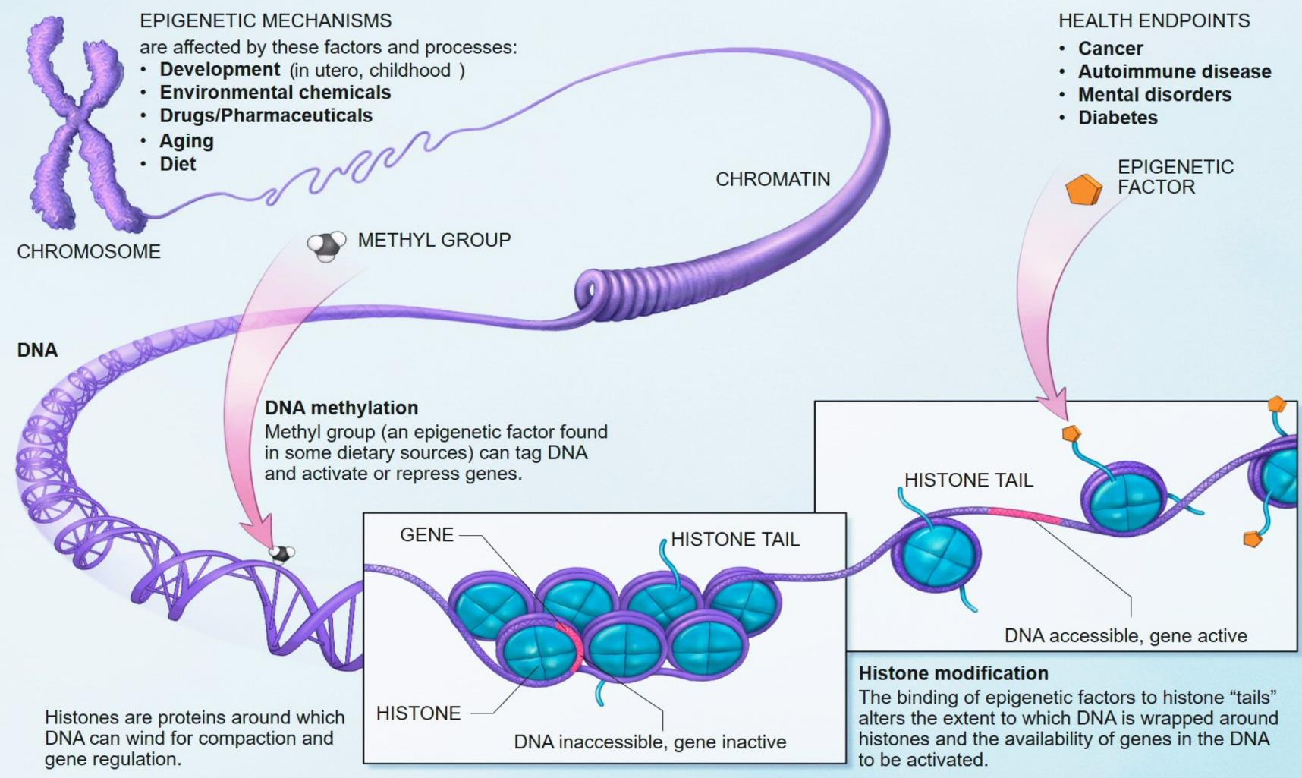
Notes:
Wikipedia

Slide 17
Conclusions of Rachel Yehuda
Given the paucity of human studies and the methodological challenges in conducting such studies, it is not possible to attribute intergenerational effects in humans to a single set of biological or other determinants at this time. Elucidating the role of epigenetic mechanisms in intergenerational effects through prospective, multi-generational studies may ultimately yield a cogent understanding of how individual, cultural and societal experiences permeate our biology.
Rachel Yehuda, Epigenetic Researcher New York.

Slide 18
Vulnerability and highly sensitive persons
Research and practical observation shows that there is a significant percentage of children who show high anxiety from early childhood.
These children tend to be more sensitive and vulnerable to stress and to new experiences in their later years.
«highly sensitive persons» have become an established concept describing emotional vulnerability
No direct correlation with trauma

Slide 19
Anxiety sensitivity is the basis of human temperament, starting very early in childhood

Slide 20
Body and Soul
Body function and feelings are closely related; The expression of physiological reactions in infants and toddlers says something about their later personality development.
Studies show that in the first few days there are different behavioral patterns in newborns (e.g. sucking behavior when changing from normal water to sweetened water = new stimulus); Two years later, those children who had reacted the most were also the most sensitive of the whole group.

Slide 21
Characteristics of anxiety-prone children (compared to children with low anxiety levels)
1. Restraint in spontaneous statements to unknown children and adults.
2. Lack of spontaneous smile towards unknown people
3. Relatively long time to relax in new situations
4. Memory impairment after stress
5. Reluctance to take risks and cautious behavior in situations that require a decision
6. Interference on menacing words in the Stroop test
7. Unusual fears or phobias
8. Significant heart rate increase during stress
9. Strong increase of diastolic blood pressure on getting up
10. Marked pupil dilation during stress
11. Increased muscle tension
12. Greater cortical activation in the right frontal area
13. More allergies
14. Blue eyes more frequent (!)
Notes:
In an emotional Stroop task, an individual is given negative emotional words like "grief," "violence," and "pain" mixed in with more neutral words like "clock," "door," and "shoe".^{[38]} Just like in the original Stroop task, the words are colored and the individual is supposed to name the color. Research has revealed that individuals that are depressed are more likely to say the color of a negative word slower than the color of a neutral word.^{[39]} While both the emotional Stroop and the classic Stroop involve the need to suppress irrelevant or distracting information, there are differences between the two. The emotional Stroop effect emphasizes the conflict between the emotional relevance to the individual and the word; whereas, the classic Stroop effect examines the conflict between the incongruent color and word.^{[38]} The emotional Stroop effect has been used in psychology to test implicit biases such as racial bias via an Implicit-association test^{[40]} . A notable study of this is Project Implicit from Harvard University which administered a test associating negative or positive emotions with pictures of race and measured the reaction time to determine racial preference^{[41]}.

Slide 22
Observation
Inhibited vs. uninhibited children:
inhibited children have a more intense reaction from the limbic to the sympathetic nervous system than uninhibited children.
Reaction to the unfamiliar with restraint, avoidance, silence and sometimes crying.
"Others start life with a physiology that makes it easier for them to be spontaneous, relaxed, and eager to explore new situations."

Slide 23
Long-term development
inhibited
15 %
Age 21 months
Not inhibited
15 %
at the age of 7.5 years:
25% (of 15%) continued to be inhibited
42% (of 15%) remain uninhibited
Influence of sex:
12 / 14 very inhibited children were girls
12 / 19 uninhibited children were boys
CONCLUSION: A positive development in inhibited children is possible, but there is an increased risk of persistent inhibition or anxiety (neuroticism)

Slide 24
Summary: Four factors of transgenerational trauma
Actual threat of terrorism, oppression, humiliation
Collective memory of trauma
Days of Remembrance
Psychosocial elements of trauma memory, family dynamics
Epigenetic influence (limited evidence)

Slide 25
Research Beyond Trauma: >>> Resilience and >>> Posttraumatic Growth

Slide 26
Resilience – a definition
Originally: the ability of a substance or object to spring back into shape; elasticity. - "nylon is excellent in wearability, abrasion resistance and resilience“
Psychology: the capacity to recover quickly from difficulties; toughness; the ability not to “break” under hard circumstances.
The ability of a child to resist biological, psychological and social risks for a healthy development.
„The immune system of the soul.“

Slide 27
Four Clusters of protective factors
Studies of resilient persons showed four clusters of protective factors which enabled high risk children to become competent and caring adults:
Special temperament properties
Ability to use their gifts successfully
Care pattern and school achievement
Caregivers and supportive relationships.

Slide 28
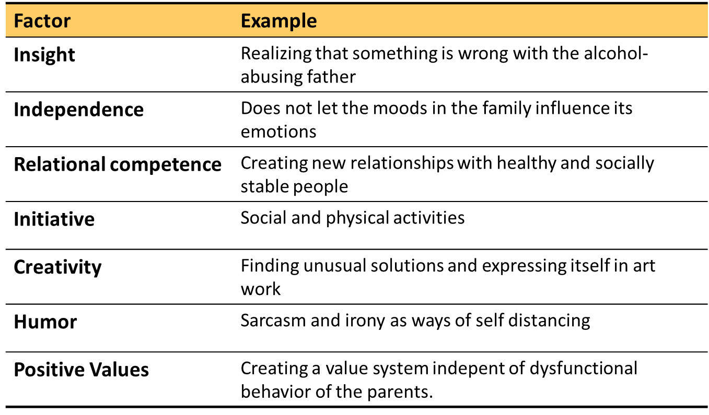
Factors of Resilience (Wolin & Wolin 1995)
Wolin, S.; Wolin, S.: Resilience among youth growing up in substance-abusing families, In: Journal of Child & Adolescent Substance Abuse, Binghamton, NY, USA: Haworth Press 42 (1995), S. 415-42.
Notes:
Wolin, S.; Wolin, S.: Resilience among youth growing up in substance-abusing families, In: Journal of Child & Adolescent Substance Abuse, Binghamton, NY, USA: Haworth Press 42 (1995), S. 415-42.

Slide 29
Factors of resilience in adults
Hardiness
Meaning of life; Belief in being able to influence the environment; learning from difficult experiences.
Self-Enhancement
In their overconfidence, they can be uncomfortable, but they are surprisingly resilient.
Coping by repression
Avoiding unpleasant thoughts, feelings and memories.
Positive feelings and humor
Gratitude, interest, love, laughter
Bonanno G.A. (2004). Loss, trauma, and human resilience. American Psychologist 59:20-28.

Slide 30
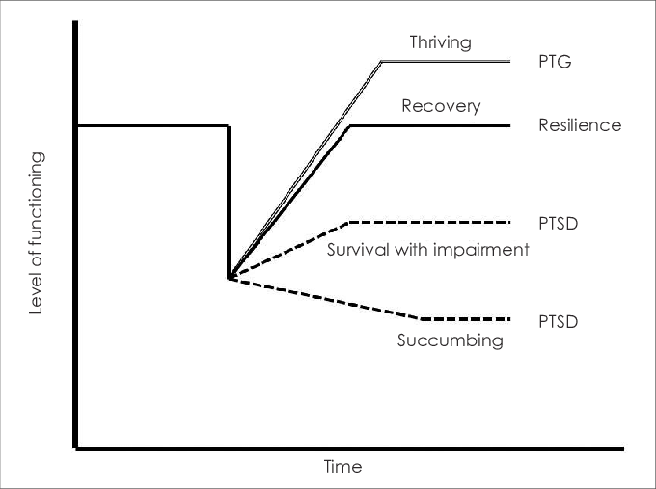
Post-traumatic Growth
New research: Positive changes in the aftermath of traumatic experience
Image: WIKIPEDIA
Notes:
Tedeschi, R. & Calhoun, L. (1995). Trauma & Transformation. CA: Sage Publications.
Posttraumatic Growth
Posttraumatic growth in children develops as a result of lessons learned from exposure to trauma or crisis (Tedeschi & Calhoun, 2004). Posttraumatic growth is manifested in several clearly defined behaviors and thought patterns not necessarily present prior to exposure (Turner & Cox, 2004). Experiences that children and adolescents may have that are associated with posttraumatic growth include (Tedeschi & Calhoun, 2004; Ungerleider, 2003):
• Feeling more compassion and empathy for others after personal trauma or loss
• Increased psychological and emotional maturity when compared to age-related peers
• Increased resiliency, the ability to “bounce back”
• A more complex appreciation of life when compared to age related peers
• A deeper understanding of one’s personal values, purpose, and meaning in life
• A greater value of interpersonal relationships
Tedeschi, R. & Calhoun, L. (1995). Trauma & Transformation. CA: Sage Publications.
Park C.L. & Fenster J.R. (2004). Stress-Related Growth: Predictors of Occurrence and Correlates with Psychological AdjustmentJ ournal of Social and Clinical Psychology 23:195-215.

Slide 31
Post-traumatic Growth
This relatively new term describes "life-changing" psychological shifts in thinking and relating to the world, that contribute to a personal process of change, that is deeply meaningful. Persons with this form of resilience show the following characteristics:
Greater Appreciation of Life and Changed Sense of Priorities
More empathy for others, who have gone through trauma and loss
More emotional maturity compared to others the same age
Increased resilience in new traumatic experiences
Warmer, More Intimate Relationships With Others
A Greater Sense of Personal Strength
Spiritual Development – stronger spiritual or religious connection.
New Possibilities: discovering new options for life
Tedeschi, R.,et al, (2018). Post Traumatic Growth: Theory, Research and Applications. New York, NY: Routledge.
Notes:
Tedeschi, R.,et al, (2018). Post Traumatic Growth: Theory, Research and Applications. New York, NY: Routledge.
Posttraumatic growth in children develops as a result of lessons learned from exposure to trauma or crisis (Tedeschi & Calhoun, 2004). Posttraumatic growth is manifested in several clearly defined behaviors and thought patterns not necessarily present prior to exposure (Turner & Cox, 2004). Experiences that children and adolescents may have that are associated with posttraumatic growth include (Tedeschi & Calhoun, 2004; Ungerleider, 2003):
• Feeling more compassion and empathy for others after personal trauma or loss
• Increased psychological and emotional maturity when compared to age-related peers
• Increased resiliency, the ability to “bounce back”
• A more complex appreciation of life when compared to age related peers
• A deeper understanding of one’s personal values, purpose, and meaning in life
• A greater value of interpersonal relationships
Tedeschi, R. & Calhoun, L. (1995). Trauma & Transformation. CA: Sage Publications.
Park C.L. & Fenster J.R. (2004). Stress-Related Growth: Predictors of Occurrence and Correlates with Psychological AdjustmentJ ournal of Social and Clinical Psychology 23:195-215.

Slide 32
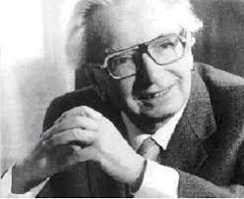
Example Viktor Frankl (1905 – 1997)
The manuscript of his book «Man’s search for Meaning» was lost in the KZ, but he kept it in his memory.
While may others were broken by the atrocities they experienced, he held on to his message: It is our calling to strive for meaning in life, even in the darkest circumstances.
«You can take everything from a person» he said, «but you cannot rob him or her of the human freedom to choose how to adapt to the given circumstances.»
Although he did not have a spiritual experience of enlightenment, it was the dark world of Auschwitz which shaped his convictions to strive for meaning no matter what.
Notes:
Der junge Neurologe, Nervenarzt und Psychotherapeut hatte noch vor der Deportation sein erstes Manuskript des Buches „Ärztliche Seelsorge“ verfasst. Eingenäht in seinen Mantel versuchte der 37-jährige es ins Konzentrationslager zu schmuggeln, doch in den Wirren verlor sich auch das Manuskript, nun nur noch in seinem Gedächtnis verankert und der schwersten Bewährungsprobe ausgesetzt, der eine positive Sicht des Lebens überhaupt begegnen konnte.
Während viele andere am Erlebten zerbrachen, blieb Frankl dabei: Es gilt, selbst in schwersten Umständen einen Sinn zu finden. „Trotzdem Ja zum Leben sagen – ein Psychologe erlebt das Konzentrationslager“ (1977/2012), so betitelte er das Buch, das er schon bald nach der Befreiung aus dem KZ verfasste. Frankl, stets berührt von der kleinsten positiven Erfahrung, wertete diese als Beweis dafür, „dass man dem Menschen im Konzentrationslager alles nehmen kann, nur nicht die letzte menschliche Freiheit, sich zu den gegebenen Verhältnissen so oder so einzustellen. Und es gab ein ‚So oder So‘!“(S.102). Frankl hatte kein spirituelles „Erleuchtungserlebnis“ wie Tournier, doch das Erleben in den Konzentrationslagern prägte und bestätigte ihn in seinen frühen Wiener Ideen.

Slide 33
Post-traumatic growth
Tedeschi et al (2018) posit that PT-Growth tends to occur in five general areas:
Appreciation of life
Relationship with others
New possibilities in life
Personal strengths
Spiritual growth: “The God on the mountain is still God in the valley”
Tedeschi, R.,et al, (2018). Post Traumatic Growth: Theory, Research and Applications. New York, NY: Routledge.
Notes:
References
Tedeschi, R.G., & Calhoun, L.G. (2004). Posttraumatic Growth: Conceptual Foundation and Empirical Evidence. Philadelphia, PA: Lawrence Erlbaum Associates.
Tedeschi, R. G., & Calhoun, L.G. (1996). The Posttraumatic Growth Inventory: Measuring the positive legacy of trauma. Journal of Traumatic Stress, 9, 455-471.
Tedeschi, R.,et al, (2018). Post Traumatic Growth: Theory, Research and Applications. New York, NY: Routledge.
Feeling more compassion and empathy for others after personal trauma or loss
• Increased psychological and emotional maturity when compared to age-related peers
• Increased resiliency, the ability to “bounce back”
• A more complex appreciation of life when compared to age related peers
• A deeper understanding of one’s personal values, purpose, and meaning in life
• A greater value of interpersonal relationships

Slide 34
Overcoming trauma through story telling
Therapy: tell your story of trauma and how you were able to deal with it:
I discovered that I’m stronger than I thought I was.
I know better that I can handle difficulties.
I changed my priorities about what is important in life.
Experiential learning allows healing to take place in "real time" - we do not talk about something; we actually engage in it. Stories of loving and comforting acts in the middle of trauma seem to strengthen healing and to change perspectives

Slide 35
Conclusions
No Determinism
Multidimensional
The human condition of vulnerability (psychological and genetic)
Resilience
Posttraumatic growth

Slide 36
Thank you for listening!
Download: www.seminare-ps.net

