Slide 1
The Problem of
DEPRESSION
Understanding and Helping in professional Counselling
Prof. Dr. Samuel Pfeifer, M.D.
Basel / Switzerland

Slide 2
Mental Health – Four trumpets
WHO: Depression is a hidden burden, affecting around 350 million people around the globe. It is the leading cause of disability worldwide.
Patients tell their stories – in our hospitals, outpatient departments, at the church doors.
Family and friends: almost every person knows at least one person who is affected with symptoms of depression
The Bible records prayers and descriptions of depressive mood.

Slide 3
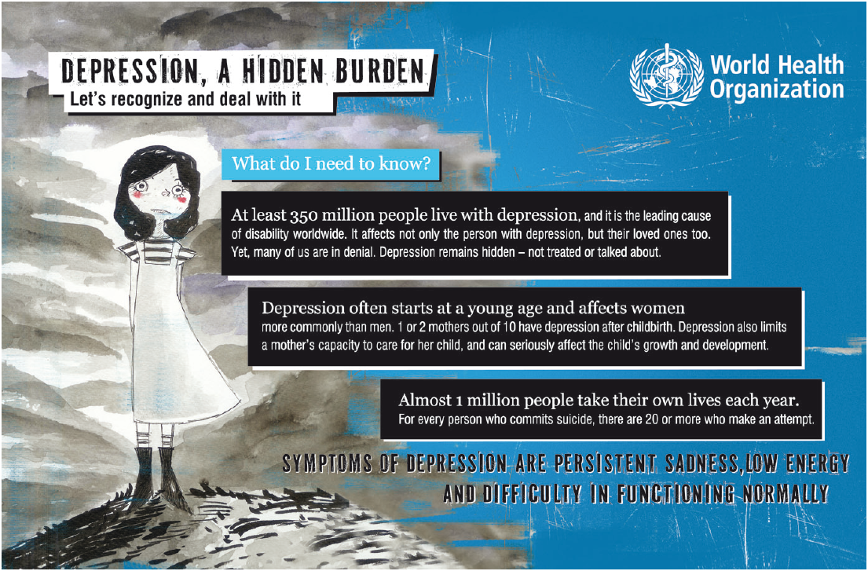

Slide 4

Patients tell their stories
Depression is a common mental disorder, characterized by sadness, loss of interest or pleasure, feelings of guilt or low self-worth, disturbed sleep or appetite, feelings of tiredness, and poor concentration.
Depression can be long-lasting or recurrent, substantially impairing an individual’s ability to function at work or school or cope with daily life. At its most severe, depression can lead to suicide.

Slide 5

Family and Friends
Who in this auditory does not know anybody affected by the symptoms of sadness, loss of energy and social withdrawal?
Not only patients themselves are affected – depression is a burden for the whole family!

Slide 6

The Bible describes depressive states
You won't find the term "depression" in the Bible. Instead, the Bible uses words such as downcast, sad, forlorn, discouraged, downhearted, mourning, troubled, miserable, despairing, and brokenhearted.
Bible people showing the symptoms of this disease: Hagar, Moses, Naomi, Hannah, Saul, David, Solomon, Elijah, Nehemiah, Job, Jeremiah.
Notes:
http://christianity.about.com/od/whatdoesthebiblesay/a/Bible-Depression.htm

Slide 7
Biblical examples
Hannah, who was barren,
Jeremiah, the "weeping prophet."
King David — “I am troubled, I am bowed down greatly; I go mourning all the day long. …I groan because of the turmoil of my heart” (Psalm 38:6,8 - NKJV).
Read Psalms 6, 13, 18, 23, 25, 27, 31, 32, 34, 37-40, 42-43, 46, 51, 55, 62-63, 69, 71, 73, 77, 84, 86, 90-91, 94-95, 103-104, 107, 110, 116, 118, 121, 123-124, 130, 138, 139, 141-143, 146-147.
The prophet Elijah went through an episode of “Burnout” after his great victory against Jezebel:
  He (Elijah) came to a broom bush, sat down under it and prayed that he might die. "I have had enough, LORD," he said. "Take my life; I am no better than my ancestors." Then he lay down under the bush and fell asleep. (1 Kings 19:4-5, NIV)

Slide 8
Spectrum of mood disturbance
Mild thru to Severe
Transience thru to Persistence
Continuous distribution in population
Clinically significant when:
  (1) interferes with normal activities
  (2) persists for min. 2 weeks
Diagnosis of depression / depressive disorder
  “Persistent & pervasive low mood”
  “Loss of interest or pleasure in activities”

Slide 9

Depression is frequent
Depression is the leading cause of disability as measured by YLDs and the third leading contributor to the global burden of disease (DALYs) in 2004. Today, depression is already the second cause of DALYs in the age category 15-44 years for both sexes combined.
YLD = Years lost due to Disability
DALY = disability-adjusted life year

Slide 10
Depression is under-diagnosed
Depression can be reliably diagnosed and treated in primary care.
Fewer than 25 % of those affected have access to effective treatments.
Antidepressant medications and brief, structured forms of psychotherapy are effective for 60-80 % of those affected and can be delivered in primary care. However, fewer than 25 % of those affected (in some countries fewer than 10 %) receive such treatments. Barriers to effective care include the lack of resources, lack of trained providers, and the social stigma associated with mental disorders including depression.

Slide 11
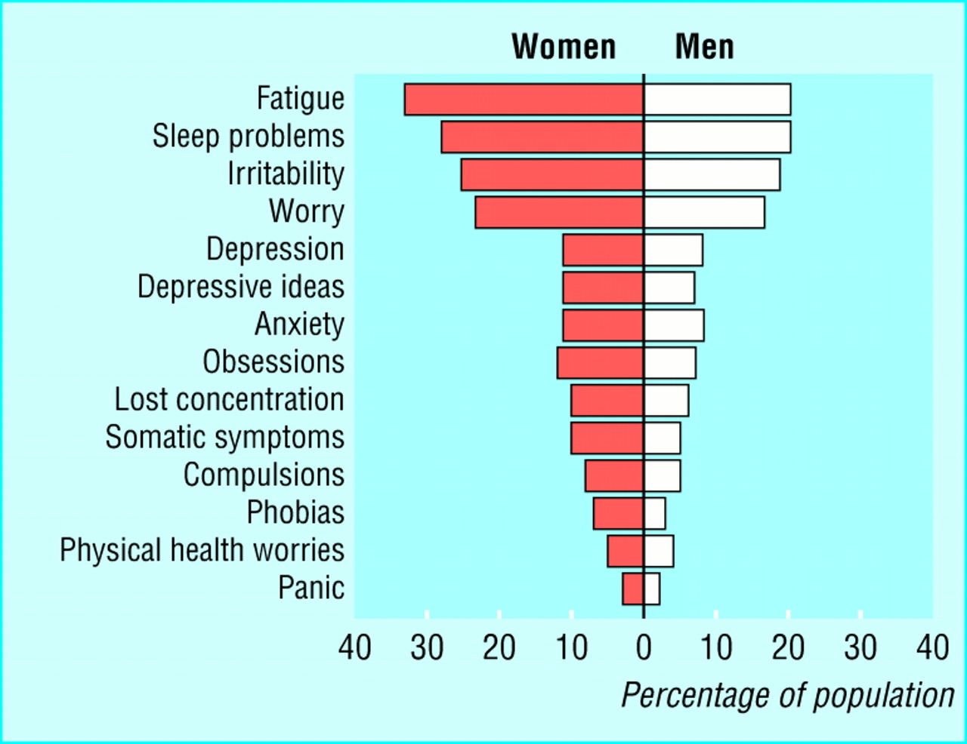
Common Symptoms

Slide 12
Basic symptoms
Depression presents with depressed mood, loss of interest or pleasure, feelings of guilt or low self-worth, disturbed sleep or appetite, low energy, and poor concentration.
These problems can become chronic or recurrent and lead to substantial impairments in an individual's ability to take care of his or her everyday responsibilities.
At its worst, depression can lead to suicide, a tragic fatality associated with the loss of about 850 000 thousand lives every year.

Slide 13
Basic symptoms
Depressed
mood
Somatic
symptoms
Motor
Symptoms
Cognitive
Disorders

Slide 14
Basic Symptoms
Depressed Mood (loss of interest or pleasure, feelings of guilt or low self-worth)
Physical complaints (lack of energy and initiative, disturbed sleep or appetite)
Cognitive disorders ( lack of concentration, difficulties in planning and decision making)
Psychomotor retardation or excitation

Slide 15

Depressed Mood
Loss of pleasure
Deep „vital“ sadness
Loss of feelings
Feeling empty
Dysphoria / anger
Feelings of guilt
Hopelessness
Anxiety

Slide 16
Depressive thought patterns
Overall negative and pessimistic view of life.
Problems concentrating or making decisions
Feelings of worthlessness or excessive, inappropriate guilt
Thoughts of death or suicide, or suicide plans or attempts.
Depressive delusions (irrational thoughts and fears)

Slide 17
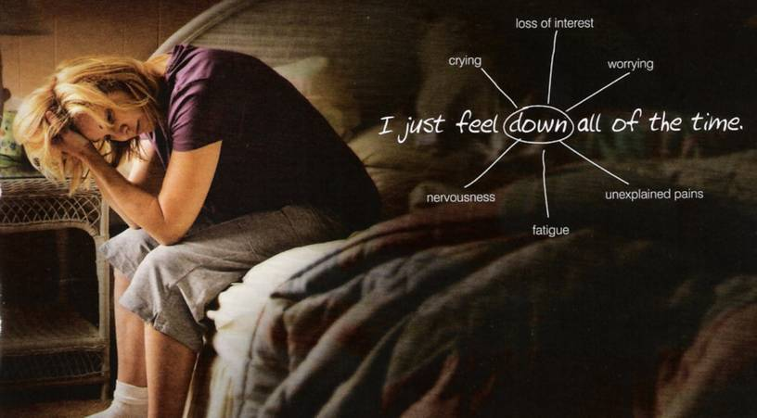
Physical symptoms

Slide 18

Physical symptoms of depression
Pain is depressing, and depression causes and intensifies pain.
People with chronic pain have three times the average risk of developing psychiatric symptoms — usually mood or anxiety disorders — and depressed patients have three times the average risk of developing chronic pain.
loss of energy or feeling tired much of the time
Insomnia or (less often) oversleeping
More: Headaches, dizziness, dry mouth; Chest discomfort, Palpitations, inner vibrations, sweating.
Weight loss, stomach complaints, flatulence, constipation, diarrhea
Urine urgency
Lack of sexual desire

Slide 19

Motor symptoms of depression
a slowdown in talking and performing tasks
or
restlessness and an inability to sit still.

Slide 20

STRESS OF MODERN LIFE
Long transfer to work
Multiple tasks that cost a lot of time and strength
unfair boss, chaotic colleagues
Desire to be a good employee
Lack of positive feedback, constant pressure
too much noise, lack of privacy, excessive distractions, and unreasonable deadlines.
Broken friendships
Distress in the family

Slide 21
Medical Causes of Depression
Depression more common in those with:
  Life threatened / limited / chronic physical illness
  Unpleasant / demanding treatment
  Low social support
  Adverse social circumstances
  Personal / family history of depression / psychological vulnerability
  Substance misuse
  Anti-hypertensive / Corticosteroid / Chemotherapy use

Slide 22

MARITAL PROBLEMS
Being confined to the house,
In-laws: no positive feedback, unreasonable demands, disrespect, cosntant criticism
«shouting man / crying woman» – ingredient of every Bollywood movie
Unfulfilled wish to have a child
No time for yourself, no time to relax
Worry / financial problems
Sexual problems

Slide 23
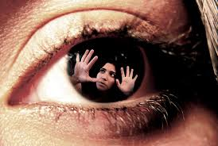
VIOLENCE / TRAUMA
Childhood trauma
Partner with alcohol problem
Threats and beatings

Slide 24
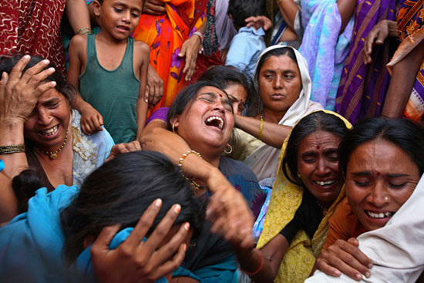
BEREAVEMENT
Losing a close relative or friend
Losing husband or wife = losing support in life

Slide 25
Key Questions for Depression
I feel sad or irritable.
I have lost interest in activities I used to enjoy.
I'm eating much less than I usually do and have lost weight, or I'm eating much more than I usually do and have gained weight.
I am sleeping much less or much more than I usually do
I have no energy or feel tired much of the time.
I feel anxious and can't seem to sit still.
I feel guilty or worthless.
I have trouble concentrating or find it hard to make decisions.
I have recurring thoughts about death or suicide, I have a suicide plan, or I have tried to commit suicide.
  Scoring Key: If you checked a total of five or more statements on the depression checklist, including at least one of the first two statements, you (or your loved one) may be suffering from an episode of major depression. If you checked fewer statements, including at least one of the first two statements, you may be suffering from a milder form of depression or dysthymia.

Slide 26
Mild, moderate, or severe?
Experts judge the severity of depression by assessing the number of symptoms and the degree to which they impair your life.
Mild: You have some symptoms and find it takes more effort than usual to accomplish what you need to do.
Moderate: You have many symptoms and find they often keep you from accomplishing what you need to do.
Severe: You have nearly all the symptoms and find they almost always keep you from accomplishing daily tasks.

Slide 27
Beck Depression Inventory (BDI)
1. Sadness
2. Hopelessness
3. Past failure
4. Anhedonia
5. Guilt
6. Punishment
7. Self-dislike
8. Self-blame
9. Suicidal thoughts
10. Crying
11. Agitation
12. Loss of interest in activities
13. Indecisiveness
14. Worthlessness
15. Loss of energy
16. Insomnia
17. Irritability
18. Decreased appetite
19. Diminished concentration
20. Fatigue
21. Lack of interest in sex
Interpretation:
Score <15: Mild Depression - Score 15-30: Moderate Depression - Score >30: Severe Depression

Slide 28
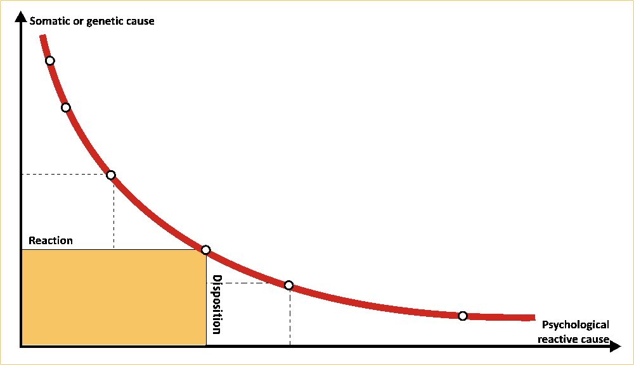
The varieties of depression
Depression caused by physical disorders
Severe Monopolar or Bipolar Depression
Old Age Depression
Dysthymia
Exhaustion / Burnout
Reactive Depression

Slide 29
Dysthymia
A low-level form of depression that lasts for at least two years. While not as crippling as major depression, its persistent hold can keep a person from feeling good and can intrude upon work, school, and social life.
Duration: dysthymia lasts for an average of at least five years.
Patients feel depressed during most of the day. They may carry out daily responsibilities, but much of the zest is gone from their life. Depressed mood doesn’t lift for more than two months at a time, and they also have at least two of the following symptoms:
  overeating or loss of appetite
  insomnia or sleeping too much
  tiredness or lack of energy
  low self-esteem
  trouble concentrating or making decisions
  hopelessness.
  Sometimes an episode of major depression occurs on top of dysthymia; this is known as double depression.
Dysthymia often begins in childhood, the teen years, or early adulthood. Being drawn into this low-level depression appears to make major depression more likely. In fact, up to 75% of people who are diagnosed with dysthymia will have an episode of major depression within five years (double depression).

Slide 30
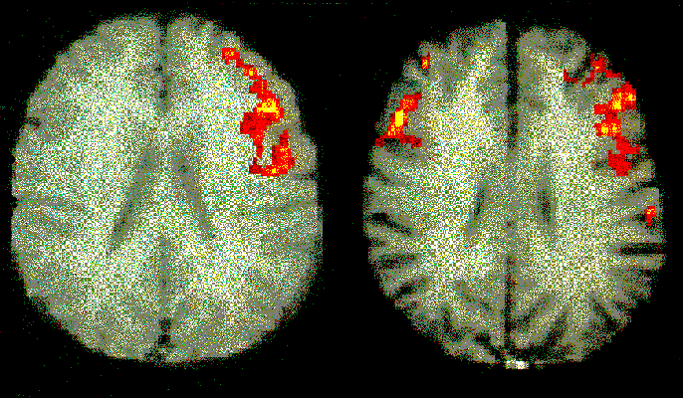
Differences male - female

Slide 31
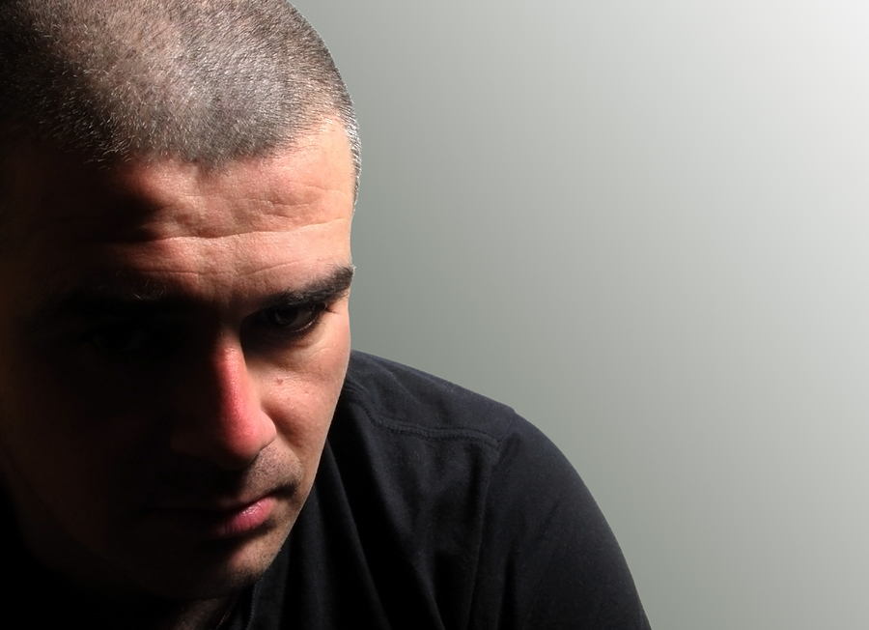
DEPRESSION
in Males

Slide 32
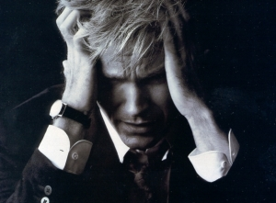
Male depression
Reduced stress tolerance
Risk taking behavior
Lack of impulse control
Actionism („acting out“)
Antisocial behavior
irritability, anger, restlessness, discontent
pessimism
Substance abuse
Genetics: depression, suicide, alcoholism
Notes:
nach Kasper 2000

Slide 33
Psychodynamics of male depression
Male in depression feels that the world set them up to fail.
Men report feelings loss of concentration and loss of interest in work and social activities, rather than the emotional feelings of profound sadness, guilt and worthlessness that women acknowledge.
Men in depression are frightened by failures.
Men tend to exhibit more anger and agitated mood states.
Male in depression faces sleeping disorders.
They feel ashamed for who they are.
Male in depression are frustrated if not praised enough and they tend to externalize depression.
They never talk about weaknesses and doubts.
A male in depression may blame his marriage instead of looking at depression as the primary problem.
Uses alcohol, TV, sports, and sex to self medicate.
They may complain more of physical aches and pains.
nach Kasper 2000

Slide 34
Male and female depression
Female depression | Male depression
Blame themselves | Feel others are to blame
Feel sad, apathetic, and worthless | Feel angry, irritable, and ego inflated
Feel anxious and scared | Feel suspicious and guarded
Avoids conflicts at all costs | Creates conflicts
Always tries to be nice | Overtly or covertly hostile
Withdraws when feeling hurt | Attacks when feeling hurt
Has trouble with self respect | Demands respect from other
Feels they were born to fail | Feels the world set them up to fail
Slowed down and nervous | Restless and agitated
Chronic procrastinator | Compulsive time keeper
Sleeps too much | Sleeps too little
Trouble setting boundaries | Needs control at all costs
Drs. Caroline Dott and Andrew Dott - www.midlife-passages.com/depressi.htm

Slide 35
Male and female depression
Female depression | Male depression
Feels guilty for what they do | Feels ashamed for who they are
Uncomfortable receiving praise | Frustrated if not praised enough
Finds it easy to talk about weaknesses and doubts | Terrified to talk about weaknesses and doubts
Strong fear of success | Strong fear of failure
Needs to "blend in" to feel safe | Needs to be "top dog" to feel safe
Uses food, friends, and "love" to self-medicate | Uses alcohol, TV, sports, and sex to self medicate
Believe their problems could be solved only if they could be a better (spouse, co-worker, parent, friend) | Believe their problems could be solved only if their (spouse, co-worker, parent, friend) would treat them better
Constantly wonder, "Am I loveable enough?" | Constantly wonder, "Am I being loved enough?"
Drs. Caroline Dott and Andrew Dott - www.midlife-passages.com/depressi.htm

Slide 36
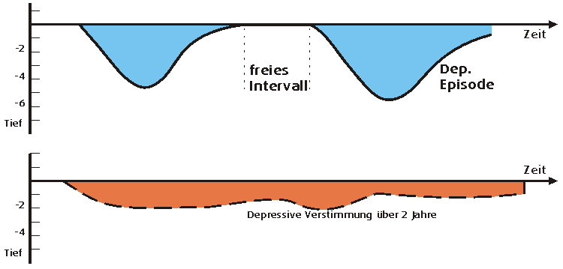
The course of depression
Severe unipolar depression
Free interval
Dysthymia
Duration longer than 2 years / less severe

Slide 37
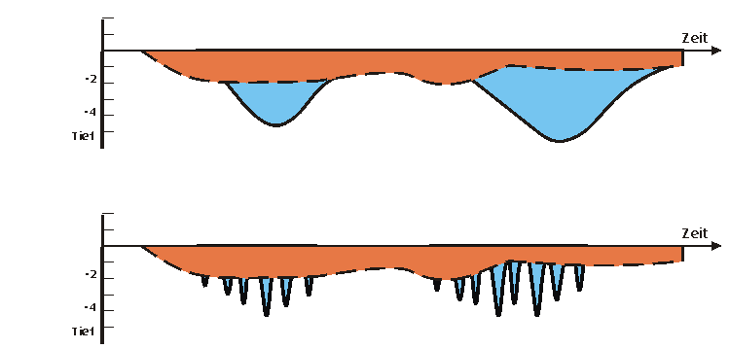
Complex forms
„Double Depression“
Very short episodes within Dysthymia

Slide 38
Unipolar depression
Dep
Dep
Depressive episodes with good times in between, but no manic phase.

Slide 39
Bipolar Disorder
Mania
Dep
Dep
grandiose ideas or pumped-up self-esteem
far less need for sleep than normal
an urgent desire to talk
racing thoughts and distractibility
increased activity that may be directed to accomplishing a goal or expressed as agitation
a pleasure-seeking urge that might get funneled into sexual sprees, overspending, or a variety of schemes, often with disastrous consequences.

Slide 40
Manic episode checklist
Check off any symptoms you've noticed for a week or longer in yourself or the person you're concerned about. Focus on symptoms that are present almost every day during most of the day.
I feel extremely elated, uninhibited, or irritable.
I have ideas or plans that will have a big impact on myself or on others.
I have a continuous stream of thoughts racing through my brain.
I am sleeping far less than I normally do.
I am talking far more than I normally do.
I feel quite distracted and find it hard to focus.
I am energetically pursuing my goals, or I feel agitated and unable to sit still.
I am actively pursuing pleasures that may have negative consequences, such as buying whatever I want or entering into sexual liaisons or business schemes.
    Scoring Key: Checking off four statements on the manic episode checklist, including the first statement, suggests possible bipolar disorder. Note that hypomanic symptoms (milder manic symptoms) may last for as little as four days, not a full week or longer.

Slide 41
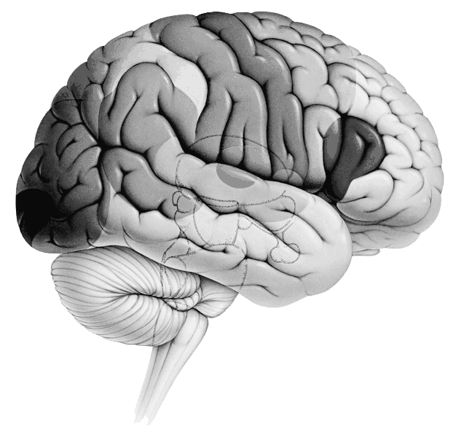
childhood
Life events
Environment
FACTORS
contributing to Depression
Thinking
Basic assumptions
„belief system“
STRESS
BRAIN
Genetics
Physical symptoms
Pain syndromes
Physical discomfort

Slide 42

Therapy
of Depression

Slide 43
Depression can be treated!
We have a responsibility to reduce stigma and to help those who are suffering.

Slide 44
Therapy of Depression
1
Thinking
Talking
Support
Activation
Medication
1
STRESS
4
2
2
3
4
Body
3

Slide 45
Depressive Thinking Patterns
Expectations
THE COGNITIVE TRIAD (A. Beck):
Negative thoughts about:
the self («I am a failure»)
the world/environment («everything is against me»)
the future («there is no way out, no hope!»
Cognitive
Dissonance
Real Condition
Self Image
Notes:
„Um glücklich zu sein, muss ich von allen Menschen akzeptiert werden.“
„Ich kann ohne ihn (sie) nicht sein.“
„Um glücklich zu sein, muss ich bei allem, was ich unternehme, Erfolg haben.“
„Wenn jemand eine andere Meinung hat, dann mag er mich nicht.“
Wenn ich meine Gefühle nicht kontrollieren kann, zeigt das, dass ich überschnappe.“

Slide 46
Treatment Steps
Evidence-based recommendations for management of depression in non-specialized health settings (WHO)
  Antidepressants (Tricyclic Antidepressants and Selective Serotonin Reuptake Inhibitors) in treatment of adults with depression
  Duration of antidepressant treatment
  Brief, structured psychological treatment
  Behavioral activation
  Relaxation training
  Physical activity

Slide 47

Medication
Medication can bring a surprising stability in depressive mood.
Tricyclic Antidepressants or fluoxetine should be considered in adults with moderate to severe depressive episode/disorder.
It takes some time until the medication brings relief.
Medication should be prescribed by the doctor and should be supported by talking about the symptoms
Side effects can be dry mouth, sweating, minor gastrointestinal symptoms, sexual dysfunction
The effect of medication is varied

Slide 48
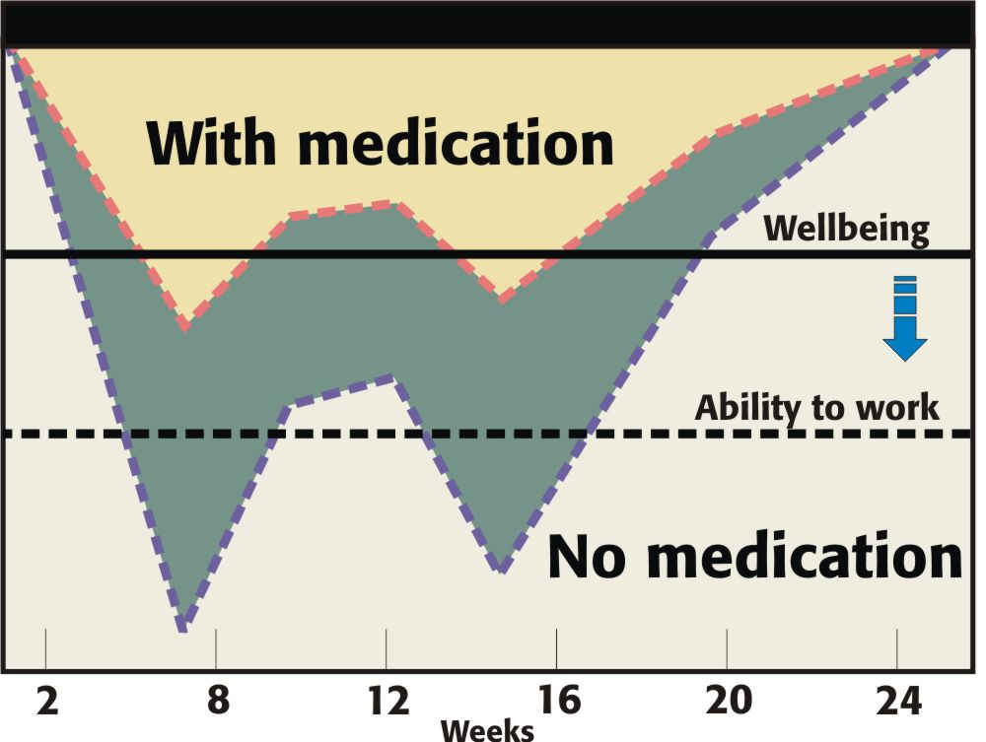
Promises and limitations of medication
Medication cannot abbreviate depression but alleviate it

Slide 49

Duration of treatment
In adult individuals with depressive episode/disorders who have benefited from initial antidepressant treatment, the antidepressant treatment should not be stopped before 9 -12 months after recovery.
Treatment should be regularly monitored, with special attention to treatment adherence. Frequency of contact should be determined by the adherence, severity and by local feasibility issues.

Slide 50
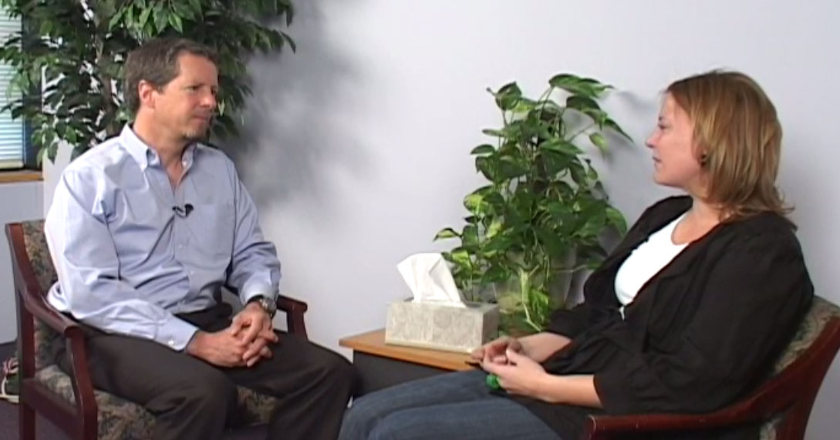
Psychological treatment (Talking therapy)
Interpersonal therapy
cognitive behavioral therapy
problem-solving treatment
should be considered as psychological treatment of depressive episode/disorder in non-specialized health care settings if there are sufficient human resources (e.g., supervised community health workers).
In moderate and severe depression, problem-solving treatment should be considered as adjunct to antidepressants.

Slide 51
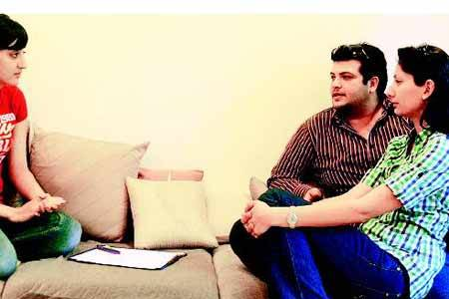
Talking about Depression
Basic attitude of unconditional acceptance.
Listening: Focus on what's going on their life in the here and now, stress at work and in relationships; their effect on mood and energy.
Give Hope: Most depressions will improve over time.
Educate about treatment options – medication, consulting with a psychiatrist etc.
Identify depressive thought patterns and help the person to develop more constructive view of life.

Slide 52
Cognitive distortions
All-or-nothing thinking – “Either I am completely well or I am a failure!”
Overgeneralization – everybody is against me, nothing helps
Mental filter - Focusing exclusively on certain, usually negative or upsetting, aspects of something while ignoring the rest, like a tiny imperfection in a piece of clothing. (See misleading vividness.)
Disqualifying the positive - Continually "shooting down" positive experiences for arbitrary, ad hoc reasons. (See special pleading.)
Catastrophizing - Focusing on the worst possible outcome, however unlikely, or thinking that a situation is unbearable or impossible when it is really just uncomfortable.
Making should statements - Concentrating on what you think "should" or ought to be rather than the actual situation you are faced with, or having rigid rules which you think should always apply no matter what the circumstances are.
  And many more
Notes:
All-or-nothing thinking - Thinking of things in absolute terms, like "always", "every" or "never". Few aspects of human behavior are so absolute. (See false dilemma.)
Overgeneralization - Taking isolated cases and using them to make wide generalizations. (See hasty generalization.)
Mental filter - Focusing exclusively on certain, usually negative or upsetting, aspects of something while ignoring the rest, like a tiny imperfection in a piece of clothing. (See misleading vividness.)
Disqualifying the positive - Continually "shooting down" positive experiences for arbitrary, ad hoc reasons. (See special pleading.)
Jumping to conclusions - Assuming something negative where there is no evidence to support it. Two specific subtypes are also identified:
* Mind reading - Assuming the intentions of others.
* Fortune telling - Predicting how things will turn before they happen. (See slippery slope.)
6. Magnification and Minimization - Inappropriately understating or exaggerating the way people or situations truly are. Often the positive characteristics of other people are exaggerated and negative characteristics are understated. There is one subtype of magnification:
* Catastrophizing - Focusing on the worst possible outcome, however unlikely, or thinking that a situation is unbearable or impossible when it is really just uncomfortable.
7. Emotional reasoning - Making decisions and arguments based on how you feel rather than objective reality. (See appeal to consequences.)
8. Making should statements - Concentrating on what you think "should" or ought to be rather than the actual situation you are faced with, or having rigid rules which you think should always apply no matter what the circumstances are. Albert Ellis termed this "Musturbation". (See wishful thinking.)
9. Labeling and Mislabeling - Explaining behaviors or events, merely by naming them; related to overgeneralization. Rather than describing the specific behavior, you assign a label to someone or yourself that puts them in absolute and unalterable terms. Mislabeling involves describing an event with language that is highly colored and emotionally loaded.
10. Personalization (or attribution) - Assuming you or others directly caused things when that may not have been the case. (See illusion of control.) When applied to others, blame is an example.

Slide 53

Behavioral activation
Behavioral activation means a structured day, with specific tasks, e.g. cooking, practical work etc.
In moderate and severe depression, this intervention should be considered as adjunct to antidepressants.

Slide 54

Relaxation training
Relaxation training may be considered as treatment of adults with depressive episode/disorder. In moderate and severe depression, this intervention should be considered as adjunct to antidepressants or structured brief psychological treatments.

Slide 55

Physical activity
Advice on physical activity should be encouraged as part of treatment for adults with depressive episode/disorder with inactive lifestyles. In moderate and severe depression, this intervention should be considered as adjunct to antidepressants or brief structured psychological treatments.

Slide 56

Depression and the spiritual life

Slide 57

Depression can darken the faith
Like a dark cloud before the sun, depression can be a dark filter not only in daily life but also in the life of faith.

Slide 58
Seven frequent spiritual worries
«Depression is a sign of sin!» (good Christians do not get depressive)
«God is punishing me!»
«I do not feel God’s presence anymore!»
«I do not get any strength our of Bible readings and prayer!»
«I am so afraid of other people, I cannot go to church!»
«I am a failure as a Christian. Others do much more for God!»
«There is no hope for me!»

Slide 59
Depressive Symptoms and religious life
Research has shown that it is not faith that makes a person unhappy, but that the depressed mood may lead to difficulties in the religious life.
Sad mood, loss of joy and interest.
Brooding and Doubt, unrest and a narrowing focus on depressive ideas.
Self reproach, guilt feelings
Lack of energy, inability to decide
Anxiety leads to withdrawal from church and fellowship
Worry and lack of perspective
Irritability and hypersensitivity
Hopelessness and death wish

Slide 60
Positive Aspects of Faith
1. Depression leads to a deepened sense of faith
2. Faith as a protection against despair and suicide
3. Faith as a source of strength in depression

Slide 61
1. Deepened faith through depression
Increased dependency on God
Deepening of personal faith
A more mature attitude towards suffering
A more compassionate attitude towards other people
Why, my soul, are you downcast? Why so disturbed within me? Put your hope in God, for I will yet praise him, my Savior and my God. . . . Psalm 42:5
I thirst for you, oh God; my whole being longs for you,
in a dry and parched land, where there is no water.
(Psalm 63:1)

Slide 62
2. Faith as a protection against despair /suicide
Hope against hopelessness
Fear of punishment in case of suicide
Death wish becomes a desire for eternity without taking suicidal action.
I have become like broken pottery. . .
But I trustc in you, Lord;I say, “You are my God.”
My times are in your hands . . . (Psalm 31:12-15)
Even though I walk through the darkest valley, I will fear no evil, for you are with me; your rod and your staff, they comfort me. . . . (Psalm 23)

Slide 63
3. Faith as a source of strength in depression
Despite despair, doubt and lack of energy
Bible verses and Christian songs
Encouragement by fellow Christians
Blessed are those whose strength is in you,
whose hearts are set on pilgrimage.
As they pass through the desert valley,
they make it a place of springs;
the autumn rains also cover it with pools.
They go from strength to strength . . . (Psalm 84)

Slide 64
Download this presentation from: www.psy77.com

