Slide 1

Mental Health and
Christian Counselling – an Introduction
Dr. Samuel Pfeifer

Slide 2
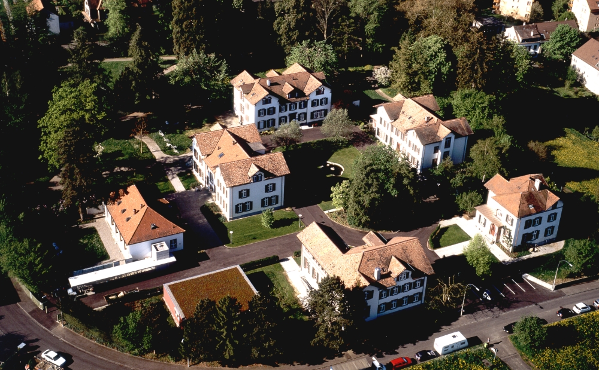

Slide 3

Klinik Sonnenhalde - unser Claim
Compassionate
Professional
Christian

Slide 4
The therapeutic network
State Clinic
INPATIENT
Health Centers
Day Care Center
Family Doctor
Psychiatrist
OUTPATIENTS
Counsellors
INPATIENT SERVICES: 65 Beds, ca. 500 patients per year
Day Care Center: 20 patients
Outpatients: >12‘000 Konsultationen pro Jahr
SHELTERED HOME

Slide 5
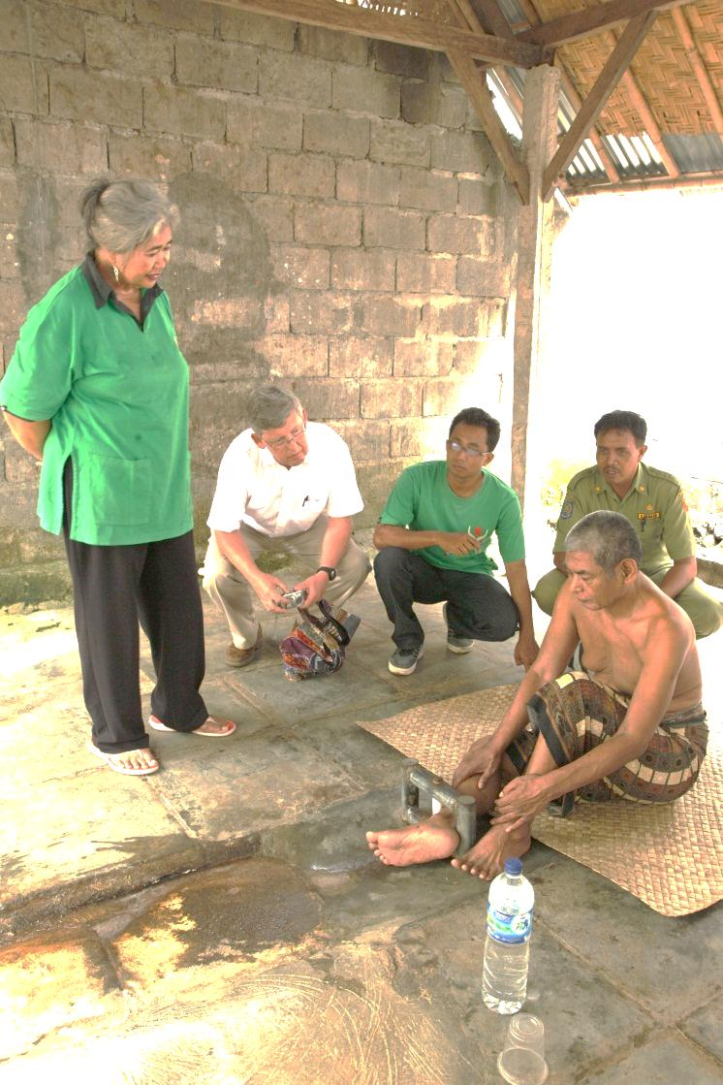
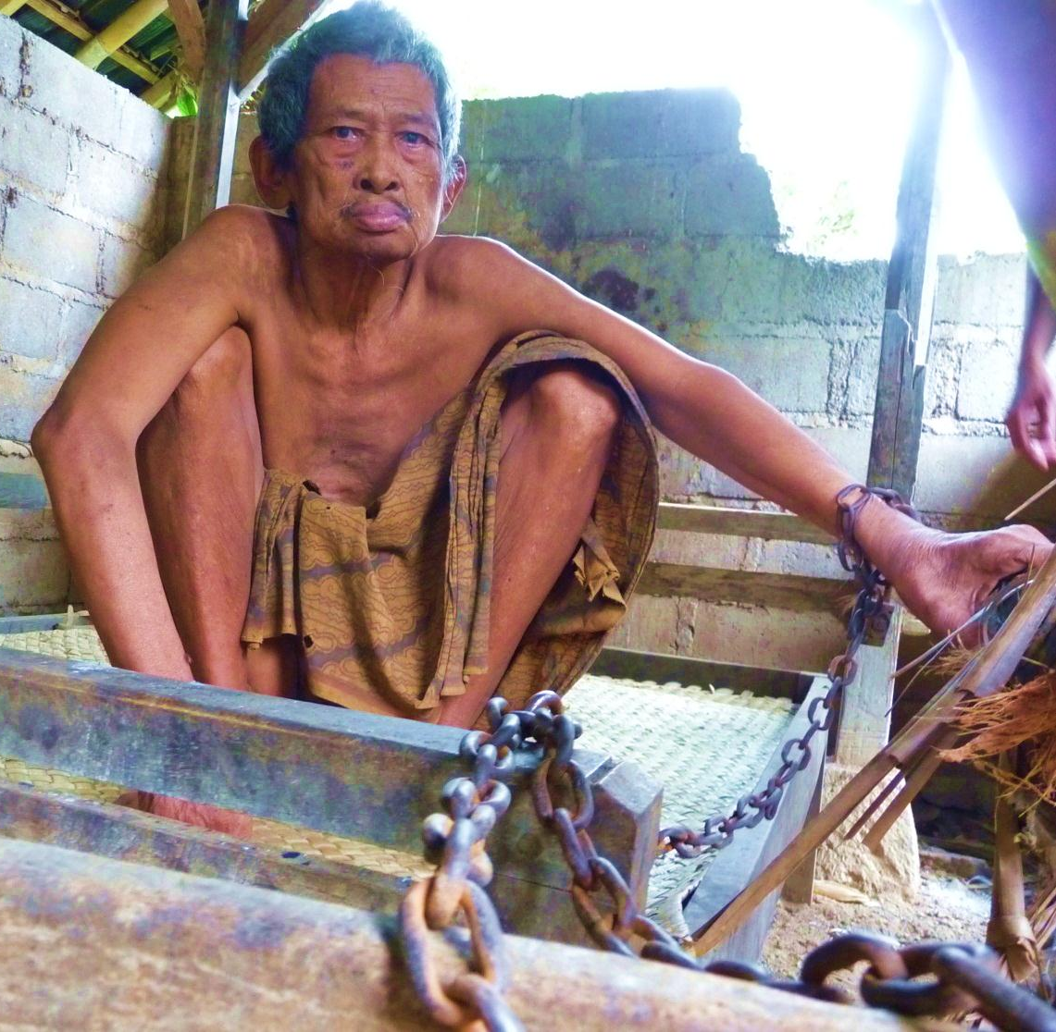
Psychiatry without medication / professional care
Patients in a Balinese village

Slide 6
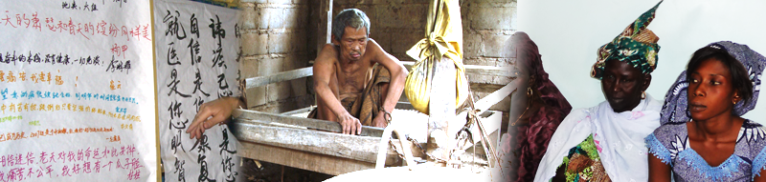

Global Mental Health
More informations: www.psy77.com

Slide 7
Bible Study: Ephesians 4:11 – 16
Which Biblical terms describe issues
of Christian Soul Care?
What is the basic attitude of a Christian Counsellor?
What are the goals of Counselling?
Notes:
Integration Bibel / Psychologie
Welche biblischen Begriffe umschreiben seelsorgliches Handeln?
Zusammentragen von Worten der Bibel, die Seelsorge umschreiben
- gesprächsorientierte Seelsorge
- non-verbale oder symbolische Seelsorge
- Beispiel des Hirten (vgl. auch Sünde der schlechten Hirten, Hes. 34,4)
Wie wird die seelsorgliche Grundhaltung in der Bibel umschrieben?
Was ist das Ziel der Seelsorge?
Bibelarbeit anhand von Epheser 4:12-16
teleios bedeutet nicht perfekt, sondern auf das Ziel der Heiligung ausgerichtet
Ziele:
Veränderung des Sinnes (Römer 12:2)
Veränderung des Wandels (Eph. 4:22-24)
Wachsen
Reifen
Stabilität
Zurüstung
Erbauung
Unterscheide Prozeß und Inhalt der Seelsorge
Prozeß = Vorgehensweise
Inhalt = Grundhaltung, Ethik, Richtlinien
Gemeinsamkeiten von Psychotherapie und Seelsorge
Unterschiede von Psychotherapie und Seelsorge

Slide 8
Ephesians 4:11 – 16
Basic Attitude
Goal
Verb
Context
In the measure of every part
According to its strength
teleios (fulness) does not mean perfect, but rather directed toward the goal of sanctification and maturity.

Slide 9
Stichworte
Equipped
Built up, edified
Reaching maturity
No longer tossed back and forth
Growing in all regards
Goal: Christ, the head of the church
Speaking truth in love
The whole body together (fittly joined)
In the measure of every part

Slide 10
Goals in Christian Counselling
Goals:
  Change of Mind (Romans 12:2)
  Change of Conduct (Ephesians 4:22-24)
  Growing
  Maturing
  Stability
  Building up
  Preparing God‘s people

Slide 11
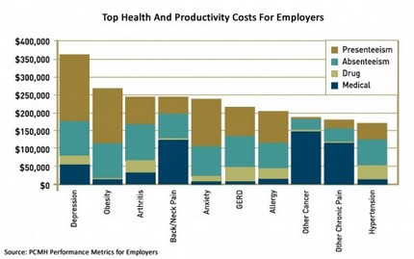
Top health problems

Slide 12
Frequency of mental disorders
SUBST DEP ANX SOM
Notes:
Quelle:
Meyer et al. (2000). Lebenszeitprävalenz psychischer Störungen in der erwachsenen Allgemeinbevölkerung. Nervenarzt 71:535-542

Slide 13
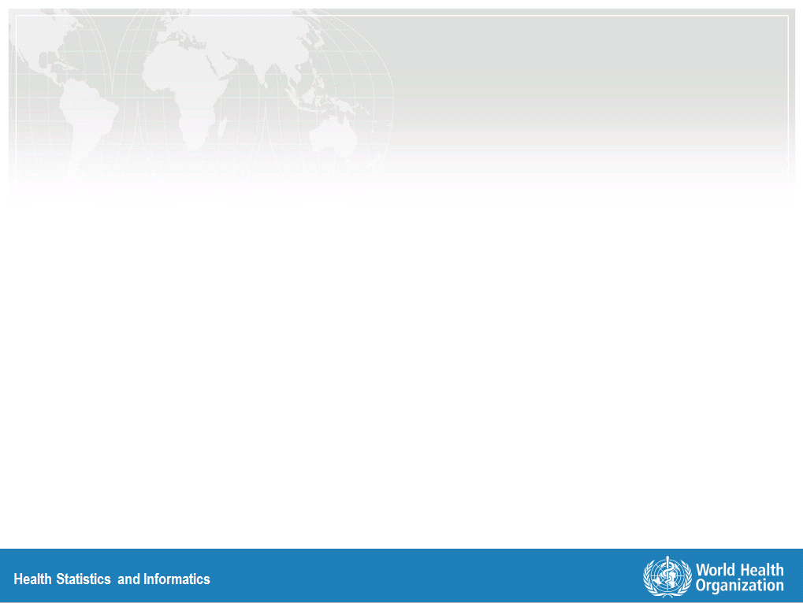
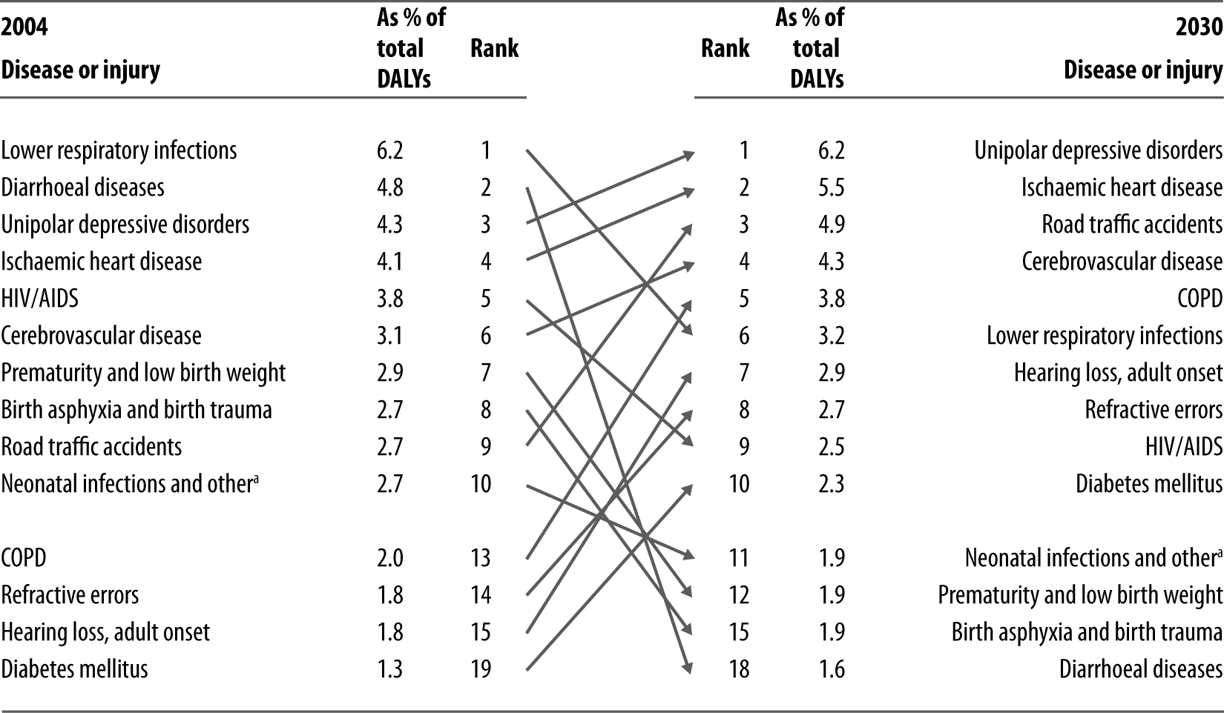
Ten leading causes of burden of disease,
world, 2004 and 2030
DALY = Disability Adjusted Life Years (Lost)

Slide 14
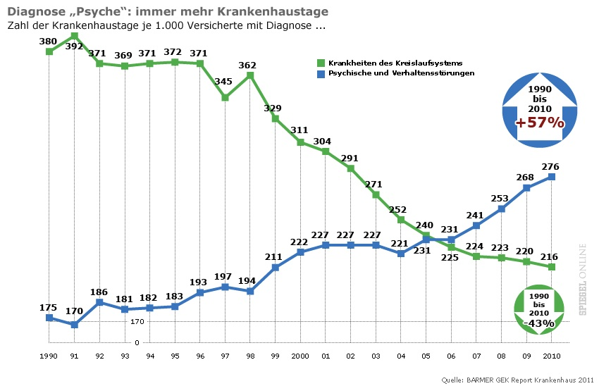
Heart problems decreasing, Depressions increasing

Slide 15
Four attitudes
Psychiatry
Religion
Psychiatry
Religion
Psychiatry
Religion
Psychiatry
Religion
Notes:
1. Psychiatry and Christian Counselling are separate fields and should not be integrated.
2. Psychiatric problems can be caused or at least deteriorated by religion.
3. Mental illness is a spiritual problem and healing can only come through faith.
4. Mental diseases are a reality of our existence in this fallen world. The Christian church is called to serve the emotionally suffering in a professional and compassionate way.

Slide 16
Four attitudes / conclusion
Psychiatry and Christian Counselling are separate fields and should not be integrated.
Psychiatric problems can be caused or at least deteriorated by religion.
Mental illness is a spiritual problem and healing can only come through faith.
Mental disorders are a reality of our existence in this fallen world. The Christian church is called to serve the emotionally suffering in a professional and compassionate way.

Slide 17
The role of faith – two dimensions
Content
Faith
Values
Environment
Structure
Friends
P e r s o n
Ideals
Support

Slide 18
Four Biblical Principles
1. Bible: 2. Tim 3:16-17
  The Bible contains basic teachings to address all problems which come up in counselling.
2. Jesus: 1.Kor 1:30, Heb 4:15-16
  In Jesus Christ we find the source for basic help in every mental or relational problem. He meets our needs and understands our weakness.
3. The Church: Phil 2:1-5
  A living Christian fellowship offers unique opportunities for inner growth and coping with the challenges of life.
4. Variety: 1. Thess 5:14
  Counselling is not a singular method, but it adapts its strategies specifically to the nature of a problem.

Slide 19
Four Biblical Strategies
1. Thessalonians 5:14
1. Exhort
Idle, unruly
2. comfort, encourage
Anxious, timid
3. support, help
The weak
4. Be patient
everyone

Slide 20
The Bio-Psycho-Social Model / Spirituality
The Causes of mental disorders are to be found in three areas. Depending on the type of disorder, there are various emphases.
Biology |  | Disposition
Social Factors |  | Relationships, Economy
Psyche |  | Reaction / mental processing
QUESTION: What is the role of spirituality? Is it a causal factor or rather a factor of coping and understanding?

Slide 21
Factors contributing to Mental Illness
PSYCHOLOGICAL
Way of Life (Eph 4,22)
Mind (Rom 8,6; 12,2)
Emotions - Thinking
Volition – Behavior
Coping - Defense
Mental
Problems
BIOLOGICAL
SOCIAL ASPECTS
Genetics, Personality
Neurobiology
Physical Constitution
Childhood, Family Life
Trauma, Life events
„Stress“
Burden
Hardships
Trials
Temptation
Gal 6,2
2. Cor 6,4
1. Peter 1,6
1. Cor 10,13
Weakness
2. Cor 12,9

Slide 22
Therapeutic avenues
Proberbs 16,24; 18,21
1. Thessalonians 5,15
Hebrews 10,24-25
T A L K I N G
Attention, Empathy,
Understanding, Counselling
Comfort, Encouragement
Teaching
Patient
M E D I C A T I O N
S U P P O R T
Antidepressants,
Neuroleptics, Mood Stabil.
Tranquilizer etc.
Visiting - Helping
Aktivation – Enabling better
autonomy
Isaiah38,21
J. Sirach 38,1-8
1. Timothy 5,23
Galatians 6,2
Matthew 25,35-40
Proverbs 3,27

Slide 23
Terminology
Severe psychiatric disorders
Anxiety disorders, mild depression, personality disorders
General Life Problems, Stress
5 %
20
40
„gesunde Menschen“
100
Psychiatry
Psychotherapy
P S Y C H O L O G Y
CHRISTIAN COUNSELING

Slide 24
Psychiatry and Christian Counselling
Psychiatry
Psychotherapy/Counselling
SEVERITY
Severe Disorders
Schizophrenia
Severe Depression
Organic brain disorders
Mild Disorders
Anxiety, doubt
low self esteem,
Stress – relationship problems
Ability to express inner distress in words

Slide 25
What are the factors which make psychotherapy helpful and effective?

Slide 26
What do psychotherapy and Counselling have in common?
1. A trustful relationship.
An explanation for the problems
  a rational cause or a mythological origin to explain the patient‘s problem is enhancing trust in the therapist / healer / counselor.
Giving new Informations
  about the causes and the dynamics of the problem. Showing new ways to cope with these difficulties
Arousing hope
  this is supporting the positive expectations.
Inducing an experience of sucess,
  in overcoming the problem and improving the quality of life.
6. Emotional involvement of the therapist.
According to J. Frank

Slide 27
Common Factors
Convincing
Relation
Expectation

Slide 28
Common Factors
Convincing
FAITH
Relation
Expectation
LOVE
HOPE

Slide 29
Common Factors
FAITH
LOVE
HOPE

Slide 30
Conclusions
1. We should be open for a deep personal awareness of human suffering beyond all categorical and theoretical considerations, moving us to compassion and motivating us to find new ways for creative caring.
2. We should be aware of new developments in our professional field, able to communicate with the world, to examine the philosophical underpinnings, critically evaluating what we can apply in our everyday practice.

Slide 31
Conclusions ctd.
3. We should be guided by the Word of God as an eternal source of wisdom and truth, practicing an exegesis that applies to the burdens, the questions and the spiritual hunger of our patients.
4. We should be guided by the principle of hope, hope which is not only rooted in the prospect of restored health, but hope in the midst of existential weakness, hope which is not only based on well-being in this world but hope that goes beyond all that our limited professional activity can achieve.

Slide 32
www.psy77.com
More Presentations on Global Mental Health in Christian Context

