Slide 1
Common mental health problems: Recognize and response
Dr. Samuel Pfeifer, M.D., Senior Consultant Mental Health
Klinik Sonnenhalde Switzerland
NOTE: for some concepts I have been inspired by the material of www.basicneeds.org

Slide 2
Mental Health problems – growing concern
WHO: Depression is a hidden burden, affecting around 350 million people around the globe. It is the leading cause of disability worldwide.
Patients tell their stories – in our hospitals, outpatient departments, at the church doors.
Major Mental Health Problems: more than 10 % of the population

Slide 3
What actually is Mental Health? What are the characteristics of a healthy mind?
Share in small groups!

Slide 4
Mental Health Defined (WHO)
A state of well-being, in which the individual ….
Realises his or her own abilities;
Can cope with the normal stresses of life;
Can work productively fully; and
Is able to make a contribution to his or her community.
A healthy person has a healthy mind and is able to think clearly;
Solve problems in life;
Work productively;
Enjoy good relationships with other people;
Feel spiritually at ease; and make a contribution to the community.
Mental health is vital for individuals, families and communities, and is more than just the absence of mental disorder.
To be a healthy person we need to have both mental and physical health, and these are related to each other.
Mental health provides individuals with the energy for active living, achieving goals and interacting with people in a fair and respectful way.
Notes:
Mental health is defined by the World Health Organization as a state of well-being in which the
individual:
Realises his or her own abilities;
Can cope with the normal stresses of life;
Can work productively fully; and
Is able to make a contribution to his or her community.
A healthy person has a healthy mind and is able to think clearly;
Solve problems in life;
Work productively;
Enjoy good relationships with other people;
Feel spiritually at ease; and
Make a contribution to the community.
Mental health is vital for individuals, families and communities, and is more than just the absence of
mental disorder.
To be a healthy person we need to have both mental and physical health, and these are related to
each other.
Mental health provides individuals with the energy for active living, achieving goals and interacting
with people in a fair and respectful way.

Slide 5
Is everything abnormal?
Normal feelings in some situations: feelings of sadness and worrying a lot
These symptoms only become a mental disorder when they are excessive and prevent the person from leading a normal life.
Other symptoms such as hearing voices are commonly symptoms of mental disorders. The different types of symptoms are closely related to each other, e.g. hearing voices saying that others are going to harm you can lead to aggression due to fear.
Experiencing the symptoms of mental disorders does not mean the individual is weak or lazy, possessed by supernatural forces, or losing his/her mind.

Slide 6
Three areas of functioning
Feelings / Emotions |  | Adequate for a situation, balanced, when upset - returning to «normal» within reasonable time,
Thinking / Cognitions |  | Alertness, interest, reality oriented, logical connections, concentration, memory, not too fast and not too slow
Behavior |  | Social context, self-care, tidiness, eating, time rhythms, adaption to social norms, relationships and work; relationship oriented, goal oriented
 |  | All these functions show individual variations .

Slide 7
General guidelines for mental problem
People with mental health problems are impaired in three areas:
Inability to enjoy life
Inability to entertain social relationships
Inability to work or fulfil social roles

Slide 8
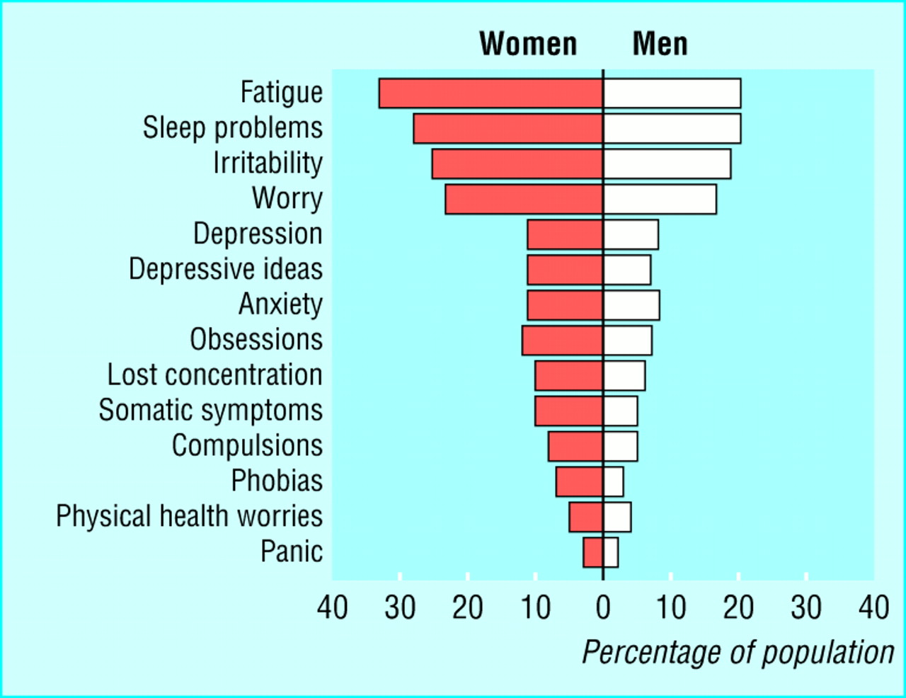
Common Symptoms

Slide 9
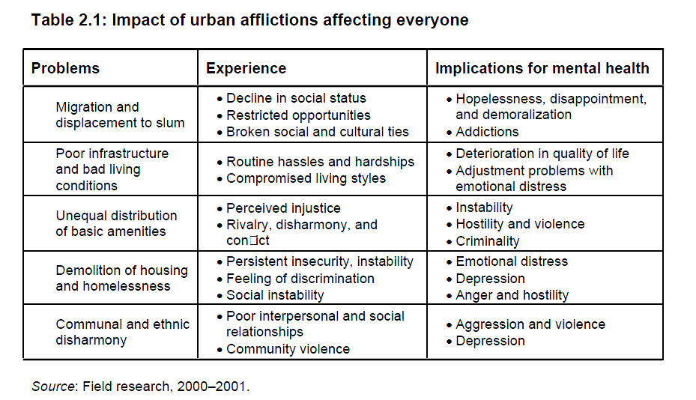
Cultural context of urban mental health
Shubanghi R. Parkar, GENDER AND THE CULTURAL CONTEXT OF URBAN MENTAL HEALTH IN MUMBAI, Disseration University of Basel 2003
Notes:
Shubanghi R. Parkar, GENDER AND THE CULTURAL CONTEXT OF URBAN MENTAL HEALTH IN MUMBAI, Disseration University of Basel 2003

Slide 10
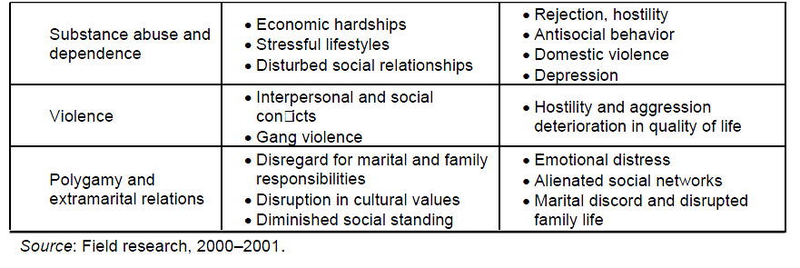
Urban afflictions affecting men

Slide 11
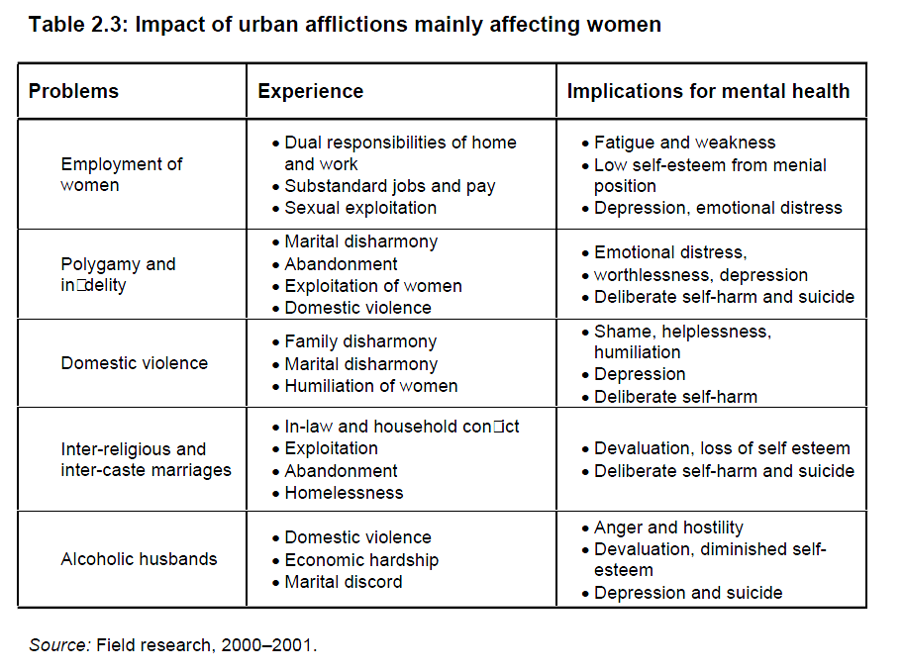

Slide 12
Common Symptoms - examples
Feelings / Emotions |  | Feeling sad or down; Excessive fears or worries, or extreme feelings of guilt; Extreme mood changes of highs and lows Excessive anger or hostility
Thinking / Cognitions |  | Diminished interest, reduced ability to concentrate Confused thinking, extremely rapid thinking Detachment from reality (delusions), paranoia or hallucinations Trouble understanding and relating to situations and to people Suicidal thinking
Behavior |  | Inability to cope with daily problems or stress Withdrawal from friends and activities Significant tiredness, low energy or problems sleeping Loss of «role behavior», goal-orientation, study performance. Inadequate behavior for social context; Alcohol or drug abuse Major changes in eating habits, Sex drive changes

Slide 13
Physical symptoms (Somatization)
Sometimes symptoms of a mental health disorder appear as physical problems.
aches and pains,
weakness, tiredness, sleep disturbance
Pressure on the heart, Palpitations
stomach pain, increased or decreased appetite.
back pain (muscular tension)
Headaches
Ringing in the ears
Etc.

Slide 14
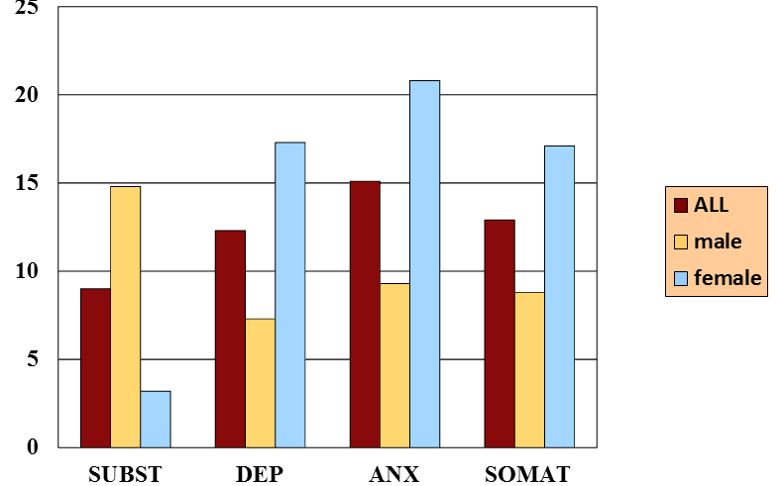
Frequency of mental problems (Germany)
SUBST = Substance abuse
DEP = Depression
ANX = Anxiety Disorders
SOMAT = somatoform disorders
In percent of the population

Slide 15
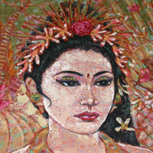
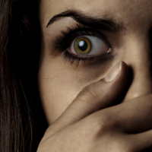
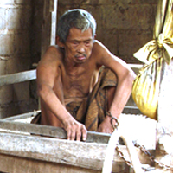
Common Mental Disorders
Depression / Mood Disorders
Anxiety and Stress Disorders
Trauma Related Disorders
NOTE: This presentation does not cover Mental Retardation, Epilepsy and Alcohol / Drug Abuse, which are also frequent.
Schizophrenia

Slide 16
Depression
Mood Disorders
Severe depression
Bipolar disorders
Postpartum depression
«Reactive Depression» triggered by social burden and interpersonal conflict

Slide 17
Spectrum of mood disturbance
Mild thru to Severe
Transience thru to Persistence
Continuous distribution in population
Clinically significant when:
(1) interferes with normal activities
(2) persists for min. 2 weeks
Diagnosis of depression / depressive disorder
“Persistent & pervasive low mood”
“Loss of interest or pleasure in activities”

Slide 18
Basic Symptoms
Depressed Mood (loss of interest or pleasure, feelings of guilt or low self-worth)
Physical complaints (lack of energy and initiative, disturbed sleep or appetite)
Cognitive disorders ( lack of concentration, difficulties in planning and decision making)
Psychomotor retardation or excitation

Slide 19
Depressed Mood
Loss of pleasure
Deep „vital“ sadness
Loss of feelings
Feeling empty
Dysphoria / anger
Feelings of guilt
Hopelessness
Anxiety

Slide 20
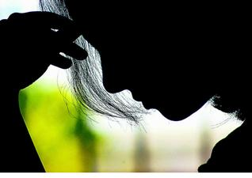
Depressive thought patterns
Overall negative and pessimistic view of life.
Problems concentrating or making decisions
Thoughts of worthlessness or excessive, inappropriate guilt
Thoughts of death or suicide, or suicide plans or attempts.
Depressive delusions (irrational thoughts and fears )

Slide 21
Physical symptoms of depression
Pain is depressing, and depression causes and intensifies pain.
People with chronic pain have three times the average risk of developing psychiatric symptoms — usually mood or anxiety disorders — and depressed patients have three times the average risk of developing chronic pain.
loss of energy or feeling tired much of the time
Insomnia or (less often) oversleeping
More: Headaches, dizziness, dry mouth; Chest discomfort, Palpitations, inner vibrations, sweating.
Weight loss, stomach complaints, flatulence, constipation, diarrhea
Urine urgency
Lack of sexual desire

Slide 22
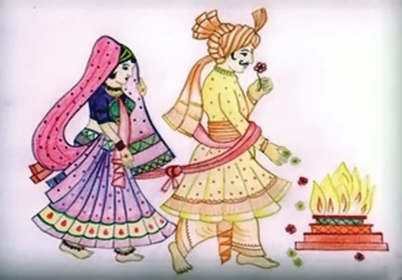
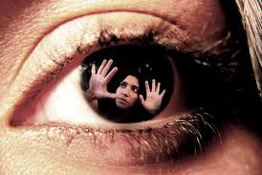
Common Problems triggering depression
Marital Problems / Family tensions
Stress of modern life
Violence / Trauma

Slide 23
Key Questions for Depression
I feel sad or irritable.
I have lost interest in activities I used to enjoy.
I'm eating much less than I usually do and have lost weight, or I'm eating much more than I usually do and have gained weight.
I am sleeping much less or much more than I usually do
I have no energy or feel tired much of the time.
I feel anxious and can't seem to sit still.
I feel guilty or worthless.
I have trouble concentrating or find it hard to make decisions.
I have recurring thoughts about death or suicide, I have a suicide plan, or I have tried to commit suicide.
Scoring Key: If you checked a total of five or more statements on the depression checklist, including at least one of the first two statements, you (or your loved one) may be suffering from an episode of major depression. If you checked fewer statements, including at least one of the first two statements, you may be suffering from a milder form of depression or dysthymia.

Slide 24
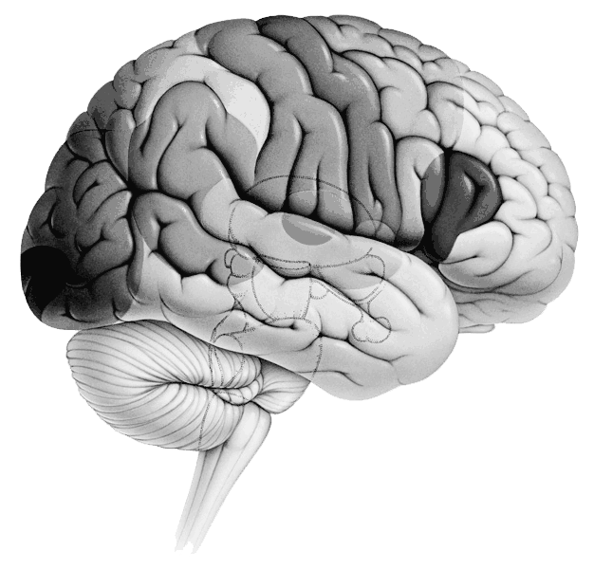
childhood
Life events
Environment
FACTORS
contributing to Depression
Thinking
Basic assumptions
„belief system“
STRESS
BRAIN
Genetics
Physical symptoms
Pain syndromes
Physical discomfort

Slide 25
Suicide – a major risk in severe depression
India has one of the highest rates of suicide
Depressive constriction of thoughts / hopelessness / negative view of self and the future
Suicide is contemplated, when there seems to be no other solution for a problem, and when there is no one to talk to

Slide 26
Depression can be treated!
We have a responsibility to reduce stigma and to help those who are suffering.

Slide 27
Therapy of Depression
1
Thinking
Talking
Support
Activation
Medication
1
STRESS
4
2
2
3
4
Body
3

Slide 28
Anxiety and Stress-related Disorders

Slide 29
Symptoms of Anxiety
Healthy Anxiety
Unhealthy Anxiety
Real dangers (anxiety is protective)
Conscience (preventing antisocial acts)
Vital anxiety in severe heart attack (warning sign)
Anxiety is not adequate in the situation
Duration much longer than the cause of anxiety
Blocking the Person: no reasonable explanation, no way to reduce anxiety or to cope with it.
Quality of life is massively reduced.

Slide 30
Many Forms of Anxiety Disorders
Agoraphobia (fear of wide spaces or closed rooms)
Social Phobia: fear of contact with other people
Isolated phobia (e.g. spiders, dogs etc.)
Panic attacks: sudden intense fear (sometimes out of nowhere in the night)
General anxiety disorder (GAD): the person worries disproportionately about day to day things, remains in stress and find it difficult to overcome fearful thoughts
Psychotic fears (often related to schizophrenia)
«I feel as if my brain is split apart, and a black atomic cloud is rising !»

Slide 31
Basic Symptoms
Feelings of Anxiety: pressure on the chest, mentally blocked
Thoughts of Anxiety: worry about life, money, loved ones, work etc., ruminations (repeating thoughts cannot be stopped), strong need for security, reassurance;
Physical Symptoms: palpitations, breathing, dry mouth, diarrhea, muscular tension, urge to go to the toilet, many other symptoms.
Triggers of Anxiety: rejection, criticism, failure, frustration, temptation, general stress of modern life …

Slide 32
STRESS OF MODERN LIFE
Long transfer to work
Multiple tasks that cost a lot of time and strength (“Multitasking”)
unfair boss, chaotic colleagues
Desire to be a good employee
Lack of positive feedback, constant pressure
too much noise, lack of privacy, excessive distractions, and unreasonable deadlines.
Broken friendships
Distress in the family

Slide 33
Trauma-related Disorders

Slide 34
Traumatic events
Characteristic: sudden, unexpected, violating the usual patterns of life in a severe way
Childhood trauma
Rape
Witnessing the death of a loved one
Road accident or other physical harm and pain
War zone experiences
Domestic violence: Threats and beatings
Partner with alcohol problem

Slide 35
Symptoms
Intrusive thoughts: Memory flashbacks (vivid re-experiencing of the trauma)
Excitation: experiencing physical signs of stress (palpitation, sweat, constantly watching out, ready to run
Constriction: isolation, withdrawal from friends and family, depressive symptoms.

Slide 36
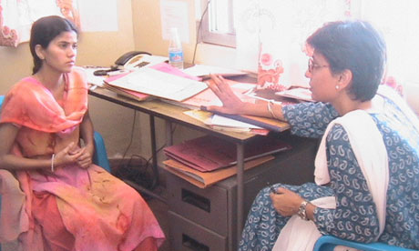
Psychological treatment (Talking therapy)
Interpersonal therapy
cognitive behavioral therapy
problem-solving treatment
should be considered as psychological treatment of depressive episode/disorder in non-specialized health care settings if there are sufficient human resources (e.g., supervised community health workers).
In moderate and severe depression, problem-solving treatment should be considered as adjunct to antidepressants.

Slide 37
Counselling or Psychiatry?
Psychiatry, medication
Counselling, talking, psychotherapy

Slide 38
Schizophrenia

Slide 39
Characteristics
Schizophrenia is frequent: about 1 percent of the population
Schizophrenia is a severe disorder, often destroying all dreams and aspirations of the person.
Onset: Gradual or rapid onset of marked behavior change after normal childhood and development.
Disturbed behavior, thoughts and incongruent feelings
«Positive Symptoms»: hearing voices, delusions = having ideas which others cannot confirm (being influenced by evil forces, being followed, poisoned, deceived, conspired against, or loved from a distance)
Characteristic: impossible, firm belief, cannot be corrected
«Negative Symptoms»: inability to work, fulfil social role, lack of energy and goal directed behavior
Stigma: if untreated – weird behavior – in rare cases aggressive

Slide 40
DSM-5 Criteria for Schizophrenia
Criterion A. Characteristic symptoms:
Two (or more) of the following, each present for a significant portion of time during a 1-month period (or less if successfully treated).
1. Delusions
2. Hallucinations
3. Disorganized speech
4. Grossly disorganized or catatonic behavior
5. Negative symptoms (i.e., diminished emotional expression or avolition)
Criterion B. Social / occupational dysfunction
Criterion C. Duration of 6 months

Slide 41
Example - Religious Delusions
A 30-year old man was arrested by the police when found lingering around an atomic power plant, being obviously disturbed. The man was not religious before the incident, but he reported that when visiting a church, he experienced an encounter with God in the shape of a light that shone through the stained-glass windows. He felt compelled to burn banknotes in the church. When he drove away, the oncoming cars and trucks gave him messages with their headlights. Finally he left his car with the ignition key on, and continued his pilgrimage on foot, spending two nights in the woods. He claimed to have received a mission from God to protect the people around the nuclear plant from harmful radiations. He therefore approached the fence around the power plant, carefully pacing up and down. Finally, he urinated into a bottle, deposing his urine in drops along the fence to create a protective wall.

Slide 42
Treatment of Schizophrenia
Delusional Thinking
Medication
Support
Activation
1
STRESS
2
1
2
3
Role Fulfillment Negative Symptoms
3

Slide 43
Therapy of Depression
1
Thinking
Talking
Support
Activation
Medication
1
STRESS
4
2
2
3
4
Body
3

Slide 44
Conclusions: How to respond to mental problems?
Awareness of people with life problems which go beyond «normal» problems.
Having trained persons in the community who are able to recognize mental illness and stress-related disorders
Being a caring community: support the person and the family
Helpline /opportunity to talk for suicidal persons
Encouraging a person to take medication
Creating supportive structures like community mental health clinics, counseling services, and sheltered homes / work places.

Slide 45
www.psy77.com
More Presentations on Global Mental Health in Christian Context

